Slide 1

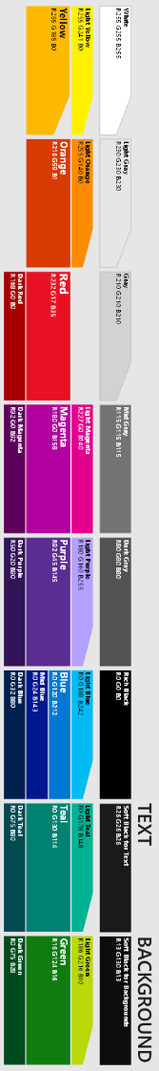


1
Microsoft Hackathon Event
“Azure SQL MI”grathon
(SQL Mod. Hack.)
Modernizing Your SQL Server Workload to Azure
February 2024 - Online
Notes:
WHY is it called SQL Migrathon ?
Hackathon Format for DB & SSIS Migration = Migrathon
SQL MIgrathon -> Word mit
->Aim: is bringing the Azure SQL closer to you, making the value of Platform services more concrete and understandable for you, for your use cases.
->1 day is full both with labs for handson experience and with small theroteical presentations and discussuions.
->During the SQL Hack, you will also that we are offering the same SQLServer & SSIS Experience in the cloud, but with full Platform Service Value without sacrificing almost any possibility in SQL Server & SSIS.

Slide 2


Coaches / Presenters
Goran Stevanovic
Cloud Solution Architect
Mert Sengüner
Cloud Solution Architect
goran.stevanovic@microsoft.com
mert.senguner@microsoft.com

Slide 3

Coaches / Presenters
Goran Stevanovic
Cloud Solution Architect
Cornel Sukalla
Cloud Solution Architect
goran.stevanovic@microsoft.com
cornel.sukalla@microsoft.com

Slide 4
Azure SQL Migrathon Agenda
Morning Session
Afternoon Session
09:00 – 09:20 | 20 mins | Introduction
09:20 – 10:05 | 45 mins | What is SQL Modernisation / Migration Paths
10:05 – 10:15 | 10 mins | Lab Environment Overview
10:15 – 10:30 | 15 mins | Break
10:30 – 11:50 | 80 mins | Lab1: Assessing & Migrating SQL Server to SQL MI
11:50 – 12:00 | 10 Mins | Wrap-Up
12:00 – 13:00 | 60 Mins | Lunch Break
13:00 – 13:05 | 5 min | Intro. To Afternoon Session
13:05 – 13:35 | 30 mins | Administering & Monitoring SQL Managed Instance
13:35 – 14:30 | 55 mins | Lab2: Administering & Monitoring SQL MI
14:30 – 14:45 | 15 mins | Break
14:45 – 15:15 | 30 mins | Securing SQL Managed Instance
15:15 – 16:10 | 55 mins | Lab3: Securing your Azure Managed Instance
16:10 – 16:20 | 10 Mins | Free Offerings from Microsoft
16:20 – 16:30 | 10 Mins | Wrap-Up
Notes:
Lab Format
PDF’s for Walkthrough
Everybody works alone on the Labs by following the instructions
Call remains open and for questions and challenges you come back, also after each lab for the discussion and QnA.
Lab1: Assessing & Migrating SQL Server Databases to Azure SQL
Scenarios: The Databases need to be migrated from SQL Server 2012 to latest versions of SQL Server. --- requirements: minimize patching and maintenance for the future but maintain full functionality.
Lab2: Administering & Monitoring Azure SQL Managed Instance
In this Lab you will explore how you can monitor and diagnose performance issues with Azure SQL Database Managed Instance using
SQL Server Management Studio, DMVs (Dynamic Management Views) and Azure Portal tools.
Lab3: Securing your Azure Managed Instance
This hands-on lab will introduce you to the layered security model available when running databases in Azure.
So this lab will focus on the Threat Protection, Information Protection and Customer Data layers of the security model and how these are implemented in
Azure SQL Managed Instance through:
• Review and configuring auditing within Azure SQL Managed Instance
• Using Data Discovery & Classification
• Azure Defender for SQL
o Vulnerability Assessment
o Advanced Threat Protection
• Information protection & encryption
o Dynamic Data Masking
o Always Encrypted

Slide 5
Azure SQL & SSIS Migrathon Agenda
Morning Session
Afternoon Session
09:00 – 09:15 | 15 mins | Introduction
09:15 – 09:50 | 35 mins | What is SQL Modernisation / Migration Paths
09:50 – 10:00 | 10 mins | Lab Environment Overview
10:00 – 10:10 | 10 mins | Break
10:10 – 11:10 | 60 mins | Lab1: Assessing & Migrating SQL Server to SQL MI
11:10 – 11:20 | 10 Mins | Wrap-Up
11:20 – 12:20 | 60 Mins | Lunch Break
12:20 – 12:25 | 5 min | Intro. To Afternoon Session
12:25 – 12:55 | 30 mins | Administering & Monitoring SQL Managed Instance
12:55 – 13:45 | 50 mins | Lab2: Administering & Monitoring SQL MI
13:45 – 13:55 | 10 mins | Break
13:55 – 14:25 | 30 mins | Securing SQL Managed Instance
14:25 – 15:20 | 55 mins | Lab3: Securing your Azure Managed Instance
15:20 – 15:25 | 05 Mins | Break
15:25 – 15:50 | 25 Mins | SSIS Migration
15:50 – 16:20 | 30 Mins | Lab4: SSIS Migration
16:20 – 16:30 | 10 Mins | Free Offerings from Microsoft & Wrap-Up
Notes:
Lab Format
PDF’s for Walkthrough
Everybody works alone on the Labs by following the instructions
Call remains open and for questions and challenges you come back, also after each lab for the discussion and QnA.
Lab1: Assessing & Migrating SQL Server Databases to Azure SQL
Scenarios: The Databases need to be migrated from SQL Server 2012 to latest versions of SQL Server. --- requirements: minimize patching and maintenance for the future but maintain full functionality.
Lab2: Administering & Monitoring Azure SQL Managed Instance
In this Lab you will explore how you can monitor and diagnose performance issues with Azure SQL Database Managed Instance using
SQL Server Management Studio, DMVs (Dynamic Management Views) and Azure Portal tools.
Lab3: Securing your Azure Managed Instance
This hands-on lab will introduce you to the layered security model available when running databases in Azure.
So this lab will focus on the Threat Protection, Information Protection and Customer Data layers of the security model and how these are implemented in
Azure SQL Managed Instance through:
• Review and configuring auditing within Azure SQL Managed Instance
• Using Data Discovery & Classification
• Azure Defender for SQL
o Vulnerability Assessment
o Advanced Threat Protection
• Information protection & encryption
o Dynamic Data Masking
o Always Encrypted
Lab4: SSIS Migration
This hands-on lab will introduce you to SSIS Packages to upgrade & migrate into Azure SQL Managed Instance catalogue for hosting and orchestrating these SSIS Packages from Azure Data Factory.
Upgrade Package using Upgrade Wizard
Convert to Project Deployment mode & update connection string
Deploy Package to the SSISDB on the Managed Instance
Verify Deployment and test run the package

Slide 6
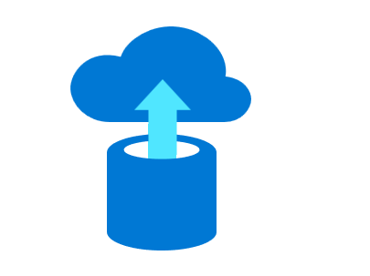
What is SQL Modernisation ?

Slide 7
Saving opportunity for modernizing your data estate is significant
Managed by customer
Managed by Microsoft
Machine-learning capability
Platform
(as a Service)
On-premises
Infrastructure
(as a Service)
On-premises costs tend to be driven by hardware and data center management costs
Infrastructure-as-a-Service reduces cost categories related to data center and compute
Platform-as-a-Service off-loads customers’ most administrative tasks to Azure, further improving efficiency with machine-learning capabilities for performance and security
Intelligent performance/security
Applications
Applications
Applications
Data
Data
Data
High availability /DR/Backups
High availability /DR/Backups
High Availability/ DR/Backups
Database Provision/ Patch/Scaling
Database Provision/ Patch/Scaling
Database Provision/ Patch/Scaling
O/S provision /patching
O/S
O/S
Virtualization
Virtualization
Virtualization
Hardware
Hardware
Hardware
Datacenter Management
Datacenter Management
Datacenter Management

Slide 8

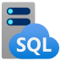
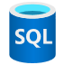
Azure SQL
The family of SQL cloud to edge databases
SQL Server on Azure Virtual Machines
Azure SQL Managed Instance
Azure SQL Database
Best for lift and shift and/or workloads requiring OS-level access
Best for modernizing existing apps
Best for supporting modern cloud apps
Infrastructure-as-a-Service
Platform-as-a-Service
Notes:
Azure SQL is a family of fully-managed, secure and intelligent SQL database services. Azure offers the widest range of deployment options for SQL from edge to cloud. With Azure SQL, you can rehost SQL workloads on SQL Server on Azure Virtual Machines, modernize existing applications with Azure SQL Managed Instance and support modern cloud applications with Azure SQL Database and Azure SQL Edge.
Azure SQL is built upon the same SQL Server engine, so you can migrate applications with ease and continue to use the tools, languages and resources you’re familiar with.
The services within Azure SQL support a variety of scenarios:
SQL Server on Azure Virtual Machines
Lift-and-shift your SQL workloads with ease and maintain with 100% SQL Server compatibility and operating system-level access
You miss here some PaaS benefits.
Azure SQL Managed Instance
Modernize your existing SQL Server applications at scale with an intelligent fully managed service
instance-scoped
high compatibility with an on-premises SQL Server
out-of-box support for a large majority of SQL Server features
So :_
migrate a large number of apps from on-premise to PaaS with as low migration effort as possible
Intelligent, fully-managed relational cloud database service
Easy lift-and-shift
Built-in security
Azure SQL Database
Support modern cloud applications on an intelligent, managed service that includes serverless compute
Serverless compute and Hyperscale storage to meet demanding workload requirements
Azure SQL Edge
IoT Edge modules are containers that run Azure services, third-party services, or custom code. They are deployed to IoT Edge-enabled devices and execute locally on those devices
You can Run IoT edge compute with a SQL database optimized with data streaming, time series, and AI capabilities built-in
Tiers _
General purpose - typical availability and common IO latency requirements
Business Critical - highest availability and lowest IO latency requirements
Hyperscale is a new, highly scalable service tier that adapts on-demand to your workload's needs
Quickly auto-scaling up to 100TB per database. (4Tb – 8 TB limits in other service tiers.)
This eliminates the need to pre-provision storage resources, significantly expanding the potential for app growth without storage size limits.
Decouples compute, log and storage.
Serverless
unpredictable and intermittent workloads
Highly autonome

Slide 9
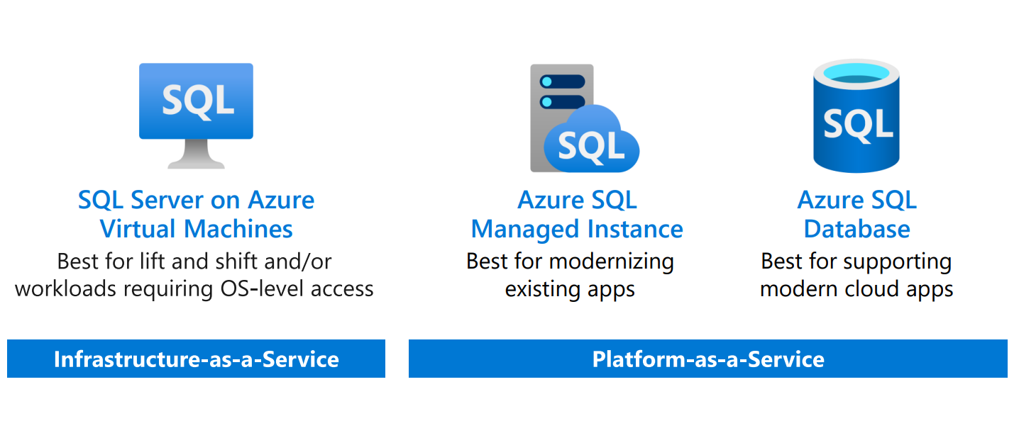
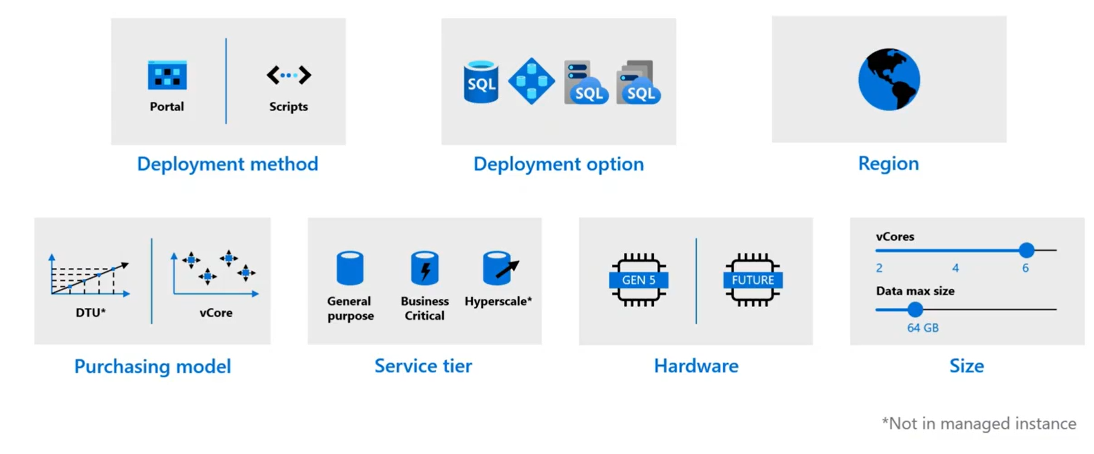
Pre-Deployment Planning
Resource limits - Azure SQL Managed Instance | Microsoft Docs
Single database vCore resource limits - Azure SQL Database | Microsoft Docs
Notes:
Region - Same place with the application to reduce the latency as much as you can
DTU – vCore -> Service Tier for the vCore Model
HW
Size
Options effect capacity or predictable performance ->
SLO
Service level objective is the combination of choices.
So for example,
Azure database / MI etc.
Vcore model / DTU model
"general purpose" / business critical
Gen 5 8 Vcores,
->
Effects resource limits (You dont explicitely choose them)
Resource limit considerations
-memory (change tier or add more vCores)
-max log size (.SQL DB -> depedend on max data size and HW generation / MI - Limited to 2 TB and currently available instance storage size)
Transaction log rate (deployment option, change tier or add more vCores)
Data iops
Size of tempdb (in BC – limited with currently available instance storage size. / in GP Limited to 24 GB/vCore)
Max concurrent workers
Very good documentation
Resource limits - Azure SQL Managed Instance | Microsoft Docs
Single database vCore resource limits - Azure SQL Database | Microsoft Docs

Slide 10
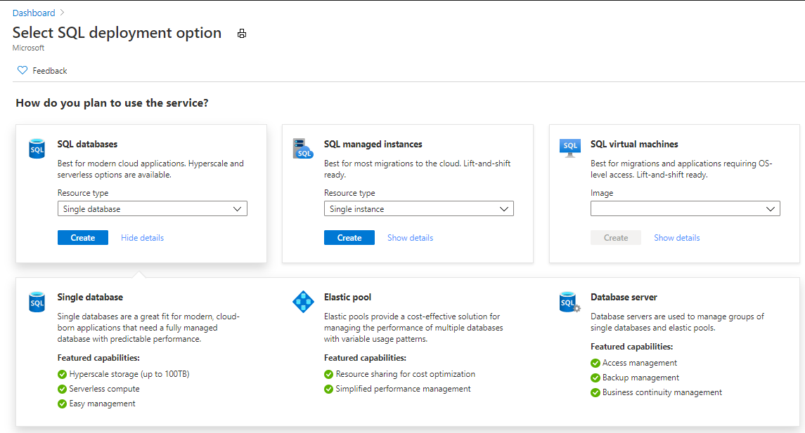
Azure SQL Database @Azure Portal
Notes:
Azure SQL is a family of fully-managed, secure and intelligent SQL database services. Azure offers the widest range of deployment options for SQL from edge to cloud. With Azure SQL, you can rehost SQL workloads on SQL Server on Azure Virtual Machines, modernize existing applications with Azure SQL Managed Instance and support modern cloud applications with Azure SQL Database and Azure SQL Edge.
Azure SQL is built upon the same SQL Server engine, so you can migrate applications with ease and continue to use the tools, languages and resources you’re familiar with.
The services within Azure SQL support a variety of scenarios:
SQL Server on Azure Virtual Machines
Lift-and-shift your SQL workloads with ease and maintain with 100% SQL Server compatibility and operating system-level access
You miss here some PaaS benefits.
Azure SQL Managed Instance
Modernize your existing SQL Server applications at scale with an intelligent fully managed service
instance-scoped
high compatibility with an on-premises SQL Server
out-of-box support for a large majority of SQL Server features
So :_
migrate a large number of apps from on-premise to PaaS with as low migration effort as possible
Intelligent, fully-managed relational cloud database service
Easy lift-and-shift
Built-in security
Azure SQL Database
Support modern cloud applications on an intelligent, managed service that includes serverless compute
Serverless compute and Hyperscale storage to meet demanding workload requirements
Azure SQL Edge
IoT Edge modules are containers that run Azure services, third-party services, or custom code. They are deployed to IoT Edge-enabled devices and execute locally on those devices
You can Run IoT edge compute with a SQL database optimized with data streaming, time series, and AI capabilities built-in
Tiers _
General purpose - typical availability and common IO latency requirements
Business Critical - highest availability and lowest IO latency requirements
Hyperscale is a new, highly scalable service tier that adapts on-demand to your workload's needs
Quickly auto-scaling up to 100TB per database. (4Tb – 8 TB limits in other service tiers.)
This eliminates the need to pre-provision storage resources, significantly expanding the potential for app growth without storage size limits.
Decouples compute, log and storage.
Serverless
unpredictable and intermittent workloads
Highly autonome

Slide 11
SQL Server on Azure VMs provides the promise of the cloud while maintaining OS control
Key features
SQL Server and OS server access
Expansive SQL and OS versions
Windows, Linux, Linux Containers
File stream/File table and Simple Recovery model
SSAS, SSRS, and SSIS
Azure differentiators
Automated manageability features for SQL Server
Point in time restore with Azure Backup
Automatic security patching
Free Extended Security Updates for SQL Server 2008/R2
If challenge is the following
I want to migrate to the cloud as fast as possible but maintain operating system control.
Solution
Get the combined performance, security, and analytics of SQL Server, backed by the flexibility, security, and hybrid connectivity of Azure
Notes:
FILESTREAM enables SQL Server-based applications to store unstructured data, such as documents and images, on the file system.
FILETABLE can store directory hierarchies in a database. It provides compatibility with Windows applications to the file data stored in SQL Server.
So SQL FILETABLE stores the file and directory attributes along with the FILESTREAM data into FILETABLE.
Simple Recovery = No log backups. Only full and differential.
If Resource Provider enabled:
Azure differentiation
1.Higher Managability ->
Manage VMs through Azure SQL in portal.
Unlock Licensing and Edition Flexibility.
2.Several PaaS features although IaaS
Automated patching for Security Updates in defined maintenance windows
Automated Backups.
Challenges
The contract on my hardware is expiring
I have instances of SQL Server 2008 and 2008 R2
I want to migrate to the cloud as fast as possible
I use third party software that needs OS-level access
I have dependencies on SSRS
I want to extend our on-premises apps to Azure
I need an unlimited number of DBs
I want the full feature set of SQL Server 20XX
Solution
SQL Server and OS server access
Expansive SQL and OS version support
File stream, DTC, and Simple Recovery model available
Automated patching and backup
Free Extended Security Updates for SQL Server 2008/R2*
435 percent overall return on an Azure IaaS investment over five years (Forrester Consulting)
Up to 3.4x faster and 87% cheaper than AWS EC2**
Azure Key Vault integration
Support for Linux and Windows
Note: maybe only 1 here – the best one, rest in notes
Does your application require custom VM or SQL config? DB engine version choice, feature compatibility with SQL box, app portability, access to VM/OS
* ESU worth 75% of license every year for the next three years after EOS; ** Applicable to Azure Marketplace images, customers using customer SQL Server 2008/R2 custom images can download the ESU for free and manually apply.
VMs: Allscripts https://customers.microsoft.com/en-us/story/allscripts-partner-professional-services-azure
Move 600 VMs to Azure within a few weeks. Some time later moving some to MI
Rehost SQL Server 2008 and 2008 R2 in Azure Virtual Machines to get three years of Extended Security Updates at no additional charge and upgrade to a newer version when ready
435 percent overall return on an Azure IaaS investment over five years (for a composite organization based on the interviewed customers) (Forrester Consulting)
https://azure.microsoft.com/en-us/overview/azure-vs-aws/cost-savings/#sql-server-iaas

Slide 12
IaaS vs PaaS (Selection)
Business continuity
Geo-replication
High availability
Scale
Automated backups
Advanced security
Long term backup retention
Version-less
Notes:
Business continuity enables your business to continue operating in the face of disruption, particularly to its computing infrastructure.
High availability of Azure SQL Database guarantees your databases are up and running 99.99% of the time, no need to worry about maintenance/downtimes.
2 read replicas - GP
3 replicas, 1 read-scale replica, zone-redundant HA - BC
Primary read/write replica + up to 4 read replicas - HS
Automated backups are created and use Azure read-access geo-redundant storage (RA-GRS) to provide geo-redundancy.
Also Point in Time restore
Long term backup retention enables you to store specific full databases for up to 10 years.
Geo-replication by creating readable replicas of your database in the same or different data center (region). You can manually failover to readable replicas
Also Auto-failover groups allows an application to recover in case of a data center outage
Scale by easily adding more resources (CPU, memory, storage) without long provisioning.
Advanced security detects threats and vulnerabilities in your databases and enables you to secure your data.
Automatic tuning analyzes your workload and provides you the recommendations that can optimize performance of your applications by adding indexes, removing unused indexes, and automatically fixing the query plan issues.
Built-in monitoring capabilities enable you to get the insights into performance of your databases and workload, and troubleshoot the performance issues.
Built-in intelligence automatically identifies the potential issues in your workload and provides you the recommendations that can help you to fix the problems.
Versionless
Azure SQL Database and Managed Instance are versionless
Our “main branch” powers SQL Server, Azure SQL Database, and Managed Instance.
Microsoft consistently updates SQL Server instances
@@VERSION does not align with SQL Server versions
Fixes and feature updates not controlled by users
But…worry-free patching for both underlying OS and SQL Server
Updates are rolled out in “trains”.
New features can be whitelisted to specific customers (aka Private Preview)
Public Preview is typically available to all but limited support and discount pricing (if applicable)
All fixes in SQL Server eventually show up in Azure but timing may be different from CU
Not all fixes in Azure make it into a CU for SQL Server (but typically next major release)
Some fixes are specific to Azure
Follow these links to see new features, major fixes, and feature updates

Slide 13
Azure SQL Managed Instance (MI) eases migration to PaaS
Key features
SQL Server surface area (vast majority)
Native Virtual Network support and Private Link support
Fully managed service
On-premise identities enabled with Azure AD and Windows Authentication
Azure differentiators
Near zero downtime migration
Fully managed business continuity with failover groups (with 5 second RPO and 30 second RTO)
The best of SQL Server with the benefits of a managed service
Link to On-Prem SQL Server
Industry highest availability SLA of 99.99(5)%
If challenge is the following
I want to migrate to the cloud, remove management overhead, take advantage of PaaS features & preserve instance-scoped features (SQL Server Agent, CLR, Linked Servers & Server Level Objects…)
Solution
SQL Managed Instance combines leading security features with SQL Server compatibility and instance model designed for on-premises customers.
Overview
SQL Server on Azure VMs
Azure SQL MI
Azure SQL Database
Comparison and summary
Notes:
Best for most lift-and-shift migrations to the cloud
It is called an Instance because it is equivalent to a Database Engine Instance of SQL Server which we define actually in our docs at https://docs.microsoft.com/en-us/sql/database-engine/configure-windows/database-engine-instances-sql-server?view=sql-server-ver15. The term Database Engine Instance is important because other instance types for SQL Server are things like SSAS.
It's called Managed because it is a PaaS version of a Database Engine Instance where we manage several things including install of SQL Server, scaling, and high-availability.
(CLR Is technology for hosting of the Microsoft . NET common language runtime engine within SQL Server. The SQLCLR allows managed code to be hosted by, and run in, the Microsoft SQL Server environment.)
Challenges
I want to migrate to Azure
I want to remove some of the management overhead and stress with regards to business continuity, high availability, and disaster recovery
I need instance-scoped features like SQL Server Agent, Database Mail, Service Broker, CLR, etc.
Solution
Single instance or Instance pool
SQL Server surface area (vast majority)
Native virtual network support
Fully managed Service
Enable your on-premise identities on cloud instances, through integration with Azure Active Directory and AD Connect
Near zero downtime migration using log-shipping
Fully managed business continuity with failover groups
Projected return on investment of 212 percent over three years (Forrester Consulting)
Combine the best of SQL Server with the benefits of a managed service
You get two levels of isolation:
Cluster level: Managed Instances for a tenant are fully isolated from other tenants. No connectivity or resource sharing is possible between different tenants.
Networking level: joining instances to a subnet in a VNET and restricting access to private IP addresses only provides full isolation from public Internet.
Managed Instance: Komatsu https://customers.microsoft.com/en-us/story/komatsu-australia-manufacturing-azure
Moved about 1.5 TBs of data very smoothly because of the near 100% compatibility with SQL Server
49% reduction in cost and 25% increase in performance gains

Slide 14
Azure SQL managed instance eases cloud migration
Key features
Fully-fledged SQL instance with nearly 100% compat with on-premise
Up to 16TB storage
Native virtual network support & private IP adressess
Fully managed service
On-premise identities enabled with Azure AD and AD Connect
Azure differentiators
Near zero downtime migration using log shipping
Fully managed business continuity with failover groups
The best of SQL Server with the benefits of a managed service
Customer challenge
I want to migrate to the cloud, remove management overhead, but I need instance-scoped features (Service Broker, SQL Server Agent, CLR…)
Solution
Managed instance combines leading security features with SQL Server compatibility and business model designed for on-premises customers

Slide 15
Service tiers – Managed Instance
General purpose
Business critical
Most business workloads
Workloads that require low latency, fast recovery, and a readable secondary
Compute hardware (Gen 5/Premium Series/Memory Optimized)
Remote storage
Local storage
IOPS
$
IOPS++
$$
In-memory
P
P
S
S
R
More Details and differences:
Notes:
Lab Format
PDF’s for Walkthrough
Everybody works alone on the Labs by following the instructions
Call remains open and for questions and challenges you come back, also after each lab for the discussion and QnA.
Lab1: Assessing & Migrating SQL Server Databases to Azure SQL
Scenarios: The Databases need to be migrated from SQL Server 2008r2 to latest versions of SQL Server. --- requirements: minimize patching and maintenance for the future but maintain full functionality.
Lab2: Administering & Monitoring Azure SQL Managed Instance
In this Lab you will explore how you can monitor and diagnose performance issues with Azure SQL Database Managed Instance using
SQL Server Management Studio, DMVs (Dynamic Management Views) and Azure Portal tools.
Lab3: Securing your Azure Managed Instance
This hands-on lab will introduces you to the layered security model available when running databases in Azure.
So this lab will focus on the Threat Protection, Information Protection and Customer Data layers of the security model and how these are implement in
Azure SQL Managed Instance through:
• Review and configuring auditing within Azure SQL Managed Instance
• Using Data Discovery & Classification
• Azure Defender for SQL
o Vulnerability Assessment
o Advanced Threat Protection
• Information protection & encryption
o Dynamic Data Masking
o Always Encrypted

Slide 16
Azure SQL Database is built for modern cloud apps
If challenge is the following
I want to build a modern multi-tenant SaaS apps and scale independently when needed
Key features
Single database or elastic pool
Hyperscale storage (100TB+)
Serverless compute
Fully managed service
Private link support
High availability with AZ isolation
Azure differentiators
Industry highest availability up to SLA of 99.995%
Industry only business continuity SLA with 5 second RPO and 30 second RTO
Solution
Azure SQL Database is a highly scalable cloud database service with built-in high availability and machine learning
It fits best for modern cloud applications as well as applications that only needs a pure relational storage
Notes:
Best for modern cloud applications
Challenges
I want to build a modern multi-tenant SaaS app
I want to use a database with dedicated resources and predictable performance
I want to independently scale compute and storage in my database
I want to have unlimited databases storage when I need it
I want to build a mission critical application with highest uptime
I want to integrate Azure services into my applications
Solution
Single database or elastic pool
Hyperscale storage (100TB+)
Serverless compute
Fully managed service
Private link
High availability with AZ isolation
Business continuity at scale
Intelligent database
Industry highest availability SLA of 99.995%
Industry only business continuity SLA with 5 second RPO and 30 second RTO
Price-performance leader for mission-critical workloads while costing up to 86 percent less than AWS RDS (GigaOm)
Database: AccuWeather https://customers.microsoft.com/en-us/story/accuweather-partner-professional-services-azure
New intelligent applications. Using Azure Machine Learning Services to make sales and customers predictions

Slide 17
Service tiers – Azure SQL Database
General purpose
Business critical
Hyperscale*
Most business workloads
Workloads that require low latency, fast recovery, and a readable secondary
Most business workloads with highly scalable storage and read-scale requirements
Remote storage
Local storage
Local + remote storage
IOPS
$
Serverless
IOPS++
$$$
In-memory
IOPS+
$
Unlimited storage
P
P
S
S
R
P
R
R
R
R
Hardware choices (Gen 5/FSv2-Compute optimized / DC-Series-Confidential computing / M-Series-Memory optimized
Provisioned
Serverless
Notes:
GENERAL PURPOSE :
Best For:
Apps with typical availability and common IO latency requirements
Storage and compute not collocated.
Fast remote Storage(Azure Premium) / Up to 8 TB
HA / Recovery Time Objective
General: Remote storage based / Good
BUSINESS CRITICAL:
Best For:
Apps with highest availability and lowest IO latency requirements
Collocated Storage and compute
Super-fast local SSD / Up to 8 TB
HA / Recovery Time Objective
Business Critical: Always On AG based / Better
HYPERSCALE is a new, highly scalable service tier that adapts on-demand to your workload's needs, auto-scaling up to 100TB per database.
You grow here without performance degradation for VLDB’s
Hyperscale is a new, highly scalable service tier that adapts on-demand to your workload's needs, auto-scaling up to 100TB per database.
Storage dynamically adapts to your workloads’ needs, auto-scaling up to 100TB.
Provision one or more additional compute nodes that can serve your read-only workload and use them as a hot-standby, in case of failover.
Perform operations in constant time, regardless of the size of the data operation.
Compute and storage resources scale rapidly and independently without sacrificing performance.

Slide 18
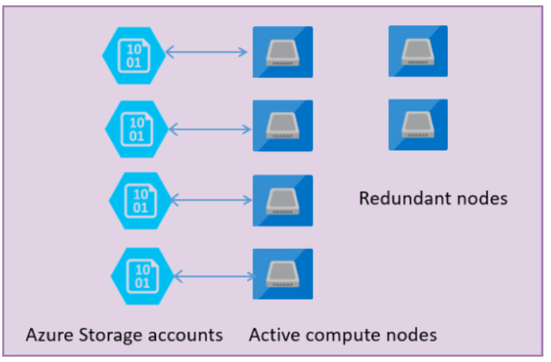
General Purpose
Feature | Description
Number of vCores* | 8, 16, 24, 32, 40, 64, 80 (Gen 5)
SQL Server version / build | SQL Server (latest available)
Min storage size | 32 GB
Max storage size | 16 TB, depending of type, series and used vCores
Max storage per database | Determined by the max storage size per instance
Expected storage IOPS | 500-7500 IOPS per data file (depends on data file). See Premium Storage
Number of data files (ROWS) per the database | Multiple
Number of log files (LOG) per database | 1
Managed automated backups | Yes
HA | Based on remote storage and Azure Service Fabric
Built-in instance and database monitoring and metrics | Yes
Automatic software patching | Yes

Slide 19
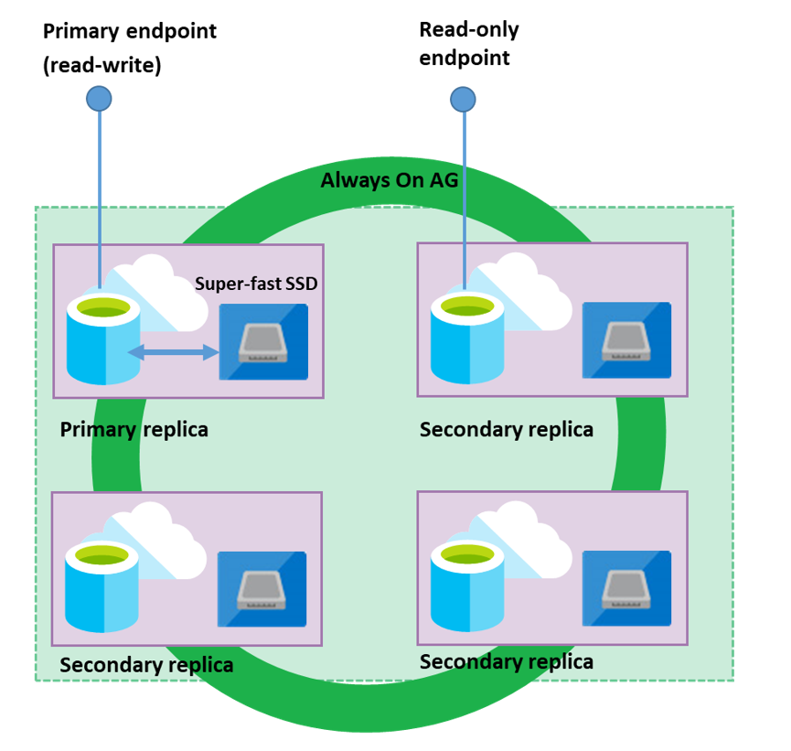
Business Critical
Feature | Description
Number of vCores* | 8, 16, 24, 32, 40, 64, 80 (Gen 5)
SQL Server version / build | SQL Server (latest available)
Additional features | In-Memory OLTP 1 additional read-only replica (Read Scale-Out)
Min storage size | 32 GB
Max storage size | between 4 TB and 16 TB, depending of used type, series and vCores
Max storage per database | Determined by the max storage size per instance
Number of data files (ROWS) per the database | Multiple
Number of log files (LOG) per database | 1
Managed automated backups | Yes
HA | Based on Always On Availability Groups and Azure Service Fabric
Built-in instance and database monitoring and metrics | Yes
Automatic software patching | Yes
Business Critical service tier: collocated compute and storage

Slide 20
Comparing Azure SQL options
SQL Server on Azure VMs
Azure SQL Managed Instance
Azure SQL Database
Azure SQL Edge
Deployment | Choose Azure VM compute and storage sizes Portal or CLI gallery images Full SQL Server Setup Bring your own image or self-install from Volume Licensing Center with active SA Images with full SQL Server or Database only setup | Dedicated instance or instance pools vCore based compute Portal or CLI instance deployment Native VNet integration | Provisioned and Serverless compute options Multi-tenancy with elastic pools Hyperscale for 100TB+ databases DTU or vCore choices Portal or CLI database deployment | Connected deployment through Azure IoT Edge Or disconnected deployment as a stand alone docker container or on a Kubernetes cluster Up to 8 cores for third party devices and no limit for first party devices Portal, Azure Data Studio, Docker or Kubernetes
Manageability | Automated backups Automated security updates Manual patching and version upgrades Dynamic VM sizing Backup and Restore with Azure Blob Storage Full SQL Server Engine features Full access to OS | Automated and user-initiated backups Point-in-time Restore Automated patching and upgrades Dynamic scaling Full Dynamic Management Views Extended Events Query Store Database Mail Resource Governor SQL Server Agent Azure Resource Health | System-initiated automatic backups Long-term backup retention Create new database based on point-in-time restore Automated patching and version upgrades Dynamic scaling Auto-scale with serverless Azure Resource Health Subset of Dynamic Management Views Extended Events Query Store | Manual patching and version upgrades Backup and Restore with Azure Blob Storage SQL Server Engine features Manage through IoT Hub as an IoT module in connected scenario
Security | Integrated Security Authentication with domain joined VM Full SQL Server Engine Security Features Azure Threat Protection and vulnerability assessments Azure Security Center and Policies for infrastructure | Azure Active Directory Authentication Transparent Data Encryption (TDE) with BYOK Always Encrypted SQL Server Audit Row Level Security and Dynamic Data Masking Advanced Threat Protection | Azure Active Directory Authentication Transparent Data Encryption (TDE) with BYOK Always Encrypted SQL Server Audit Row Level Security and Dynamic Data Masking Advanced Threat Protection | Transparent Data Encryption (TDE) Always Encrypted Row Level Security and Dynamic Data Masking Advanced Threat Protection Role-based access control (RBAC) and attribute-based access control (ABAC).
Business Continuity | Full Always On Availability Groups (AG) Always On Failover Cluster Instance SQL Server replication Change Data Capture Log Shipping Database Snapshots Accelerated Database Recovery Tempdb Optimized Metadata | Built in Azure HA/DR Built-in readable secondary using geo-replication Auto Failover Groups SQL Server Replication Change Data Capture Accelerated Database Recovery on by default | Built in Azure HA/DR Built-in readable secondary using geo-replication Availability Zones Active geo-replication SQL Data Sync Accelerated Database Recovery on by default | Kubernetes Orchestrator SQL Data Sync Accelerated Data Recovery on by default
*This comparison is intended as a guide and subject to change without notice. SQL Server on Azure VM feature availability may be limited to specific SQL Server versions. For detailed comparisons, please see our documentation at aka.ms/AzureSQL_documentation

Slide 21
Comparing Azure SQL options (continued)
SQL Server on Azure VMs
Azure SQL Managed Instance
Azure SQL Database
Azure SQL Edge
Performance | Automatic Plan Correction Full SQL Server Engine Performance Features Azure Blob cache High performance ultra disks | Intelligent Query Processing Columnstore Indexes Memory Optimized Tables Automatic Plan Correction | Intelligent Query Processing Columnstore Indexes Memory Optimized Tables Automated Tuning including Indexes and Plan Correction | Intelligent Query Processing Columnstore Indexes Automated Tuning and Plan Correction Query Store
Programmability | All major programming languages Server-level collations UTF-8 T-SQL JSON integration Graph database Common Language Runtime Native cross database queries PolyBase external tables for Big Data New PolyBase connectors Java language extension Distributed transactions FileStream Full T-SQL surface area | All major programming languages Server-level collations UTF-8 T-SQL JSON integration Graph database Common Language Runtime Native cross database queries PolyBase external tables for Big Data Distributed transactions Linked Servers Service broker | All major programming languages Database-level collations UTF-8 T-SQL JSON integration Graph database | All major programming languages Database-level collations UTF-8 T-SQL JSON integration SQL Graph XML
Networking | Public Endpoint with Network Security Group (NSG) Private Endpoint with Native Azure Vnet | Public Endpoint with Network Security Group (NSG) Private Endpoint with Native Azure Vnet | IP Firewall for Public Endpoint Virtual Network Firewall within Azure Private Endpoint with PrivateLink (preview) | N/A
Analytics and BI | SQL Server Integration Services (SSIS) SQL Server Reporting Services (SSRS) SQL Server Analysis Services (SSAS) Machine Learning Server (standalone) Machine Learning Services and language extensions Full-text and semantic extractions for search | Machine Learning Services with R and Python Compatible with: Azure Data Factory SSIS integration runtime Migrate SSRS to Power BI paginated reports Azure Analysis Services | Compatible with: Azure Data Factory SSIS integration runtime Migrate SSRS to Power BI paginated reports Azure Analysis Services | Compatible with: Azure Data Factory SSIS integration runtime Migrate SSRS to Power BI paginated reports Azure Analysis Services R and Python through ONNX
Storage limits | Instances up to 256 TB | Instance up to 8 TB (16TB in preview) | Databases up to 4 TB (100 TB with Hyperscale) | Dependent on edge device capacity
SLA | SLA varies based on tier level. Max 99.99% HA SLA when distributed between AZ | 99.99% availability SLA at instance level (99,995% with Zone Redundancy in preview) | Up to 99.995% availability SLA at database level | N/A
*This comparison is intended as a guide and subject to change without notice. SQL Server on Azure VM feature availability may be limited to specific SQL Server versions. For detailed comparisons, please see our documentation at aka.ms/AzureSQL_documentation

Slide 22
What are the Migration Paths ?

Slide 23
Migrating databases to azure
Combining the best of SQL Server with the benefits of Azure
Migrating SQL Server Databases to Azure has
3 key decision points:
Which Database flavor is best for my Application?
What is the best process for migration?
What tools can I use to make migration more efficient?
And for All Up Modernization – how do I do that at scale?

Slide 24
Which Azure SQL offering is right for you?
Migration
Do you need
OS level access?
Filestream?
Capabilities at the VM level?
SSRS/SSAS?
Yes
SQL Server on Azure VMs
No
Migration & App Mod.
Do you need
An instance model?
Linked Server?
Cross-DB transactions?
SQL Agent?
Capabilities at the instance level?
SSIS?
Yes
Azure SQL Managed Instance
App Innovation
No
Do you need
No
Yes
Azure SQL Database
A database model?
Up to 100TB of database storage?
Ability to automatically pause/restart a workload?

Slide 25
Database migration process overview
Post-migration
Optimize
Based on the tests you performed, address any performance issues, and then retest to confirm the performance improvements
Pre-migration
Migration
Discover
Assess
Migrate databases, server objects
Data sync
Cutover
Remediate applications
Iteratively make any necessary changes to your applications
Inventory database assets, and application stack discovery
Assess workloads and fix recommendations
Migrate the source schema, and then migrate the source data to the target
Sync your target data with the source. This is only relevant for minimal-downtime migrations
Cut over from the source to the target environment. This is only relevant for minimal-downtime migrations
Run functional & performance tests
Iteratively run functional and performance tests
Notes:
SQL Server to SQL Server on Azure Virtual Machines: Migration guide - SQL Server on Azure VMs | Microsoft Docs
SQL Server to SQL Managed Instance: Migration overview - Azure SQL | Microsoft Docs
PreDeployment planning
New or Existing (Migration)?
Before migraiton / during mogration / after migration
Pre –mig -> DISCOVER and asess all servers, databases and also applications to know :
what is going to move
where is it going to move
The inventory of data estate (Maps Toolkit or AMA)
Application - database dependencies
What databases move together / priority
ASSESS
Which deployment option (VM,PaaS -MI)
Do I have to do Lift and Shift or can I modernize
Size & Tier of the DB Service -> Intelligent workload right-sizing and costing
The migration blockers
Breaking changes
Features to leverage
Effort involved to fix issues
Workload configuration analyses and recommendations
Example:
Azure Migrate is the Hub for discovery and assessment.
If you are assessing the entire SQL Server data estate at scale on VMWare, HyperV or pyhiscal environment, use Azure Migrate to get Azure SQL deployment recommendations on portal.
Needs an appliance ro collect data (Azure Migrate Appliance)-> for lot of SQL servers, lots of instances
You run this on a light-weight secure agent. This discoveras all of your assets,
Not only tell what you have oin your environment - but it gives you recommendations > Service tier to pick, target size, what is the best option ? Cost estimate ?
Convert is more for Oracle etc.
Once you figure out : Do the migration
Offline <> Online
Migrate and synch data.
Where you are ready to switch. Then cut over and carry on in the cloud
Make sure, everything works.
Optimize - not only performance but also for size and price
Custom guide
Azure Database Migration Guides | Microsoft Docs

Slide 26
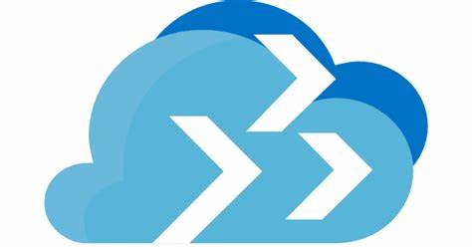




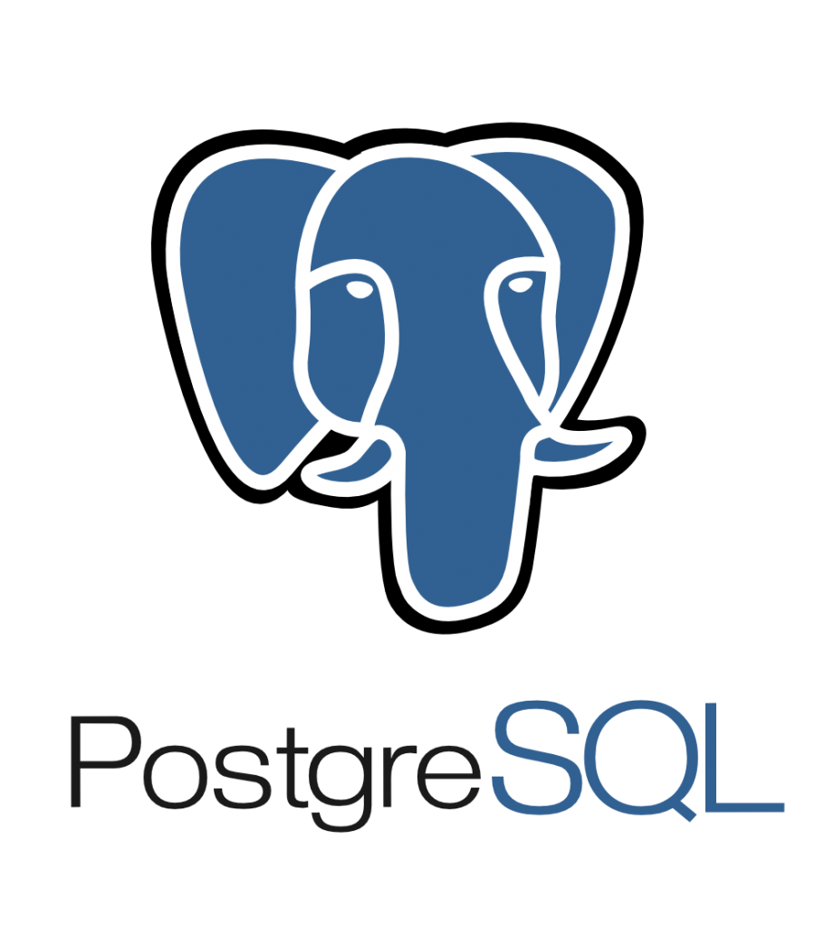






Tools and services for your migration journey
Microsoft Azure
Scale Migration
Lift and Shift
Azure Migrate
Discover and Assess (& Migrate to Azure VM at scale)
Server Migration
Re-Platform
Assessment
Azure Migrate,
Data Migration Assistant (DMA)
Azure Data Studio
Migration
Azure Database Migration Service (DMS)
Notes:
Azure Migrate
Primary Azure service for orchestrating migration from on-premises to Azure.
It Discovers and create an Inventory of all applications, databases, and VMs.
Assess dependencies between machines.
Suitable for large scale migrations to Azure if SQL Server VM (IaaS)
Can scale migration workloads of up to 35000 VMs.
Azure Migrate is the Hub for discovery and assessment.
If you are assessing the entire SQL Server data estate at scale on VMWare, HyperV or pyhiscal environment, use Azure Migrate to get Azure SQL deployment recommendations on portal.
Needs an appliance to collect data (Azure Migrate Appliance)-> for lot of SQL servers, lots of instances
You run this on a light-weight secure agent. This discoveras all of your assets,
Not only tell what you have oin your environment - but it gives you recommendations > Service tier to pick, target size, what is the best option ? Cost estimate ?
Azure Site Recovery
Disaster recovery solution, which can also be used large scale migrations
(Site Recovery scripts are available for your download at Azure PowerShell Samples)
Database Migration Assistant (target agnostic)
Assess database compatibility (blocking issues) and feature parity (unsupported functions or behavior Changes) (between source and target)
Also, So that you can decide which deployment option to take and what SKU.
Example behaviour change:
Starting with database compatibility level 90 and higher, in rare occasions, the 'unqualified join' syntax can cause 'missing join predicate' warnings, leading to long running queries.
Data Access Migration Toolkit (preview)
very useful tool to understand migration comparability issues or blockers from the application point of view.
provides tools to help migrate application source code from one database platform to another.
Discover and extract SQL queries from files (supported file types)
Java
C#
XML
JSON
Properties
SQL files
Plain text / Unstructured
Database Migration Service
Enables offline & online migrations to Azure SQL PaaS
Sql Server to all deployment options (Exception.: Online Migration to SQL VM)
Azure Data box
When you need to easily move data to Azure and when busy networks aren’t an option.
Move large amounts of data to Azure when you're limited by time, network availability, or costs,
DEA –
Evaluate target version of SQL Server for a given workload
Microsoft and third parties have developed a set of tools to assist with each phase of the migration process, from discovery to migration to optimization. In many cases, the third-party tools complement those built by Microsoft. For example, in the migrate stage, CloudEndure provides support for a wider range of virtual machines and uses a slightly different replication technique that might be appropriate for some organizations. Velostrata is often used when a fast-paced migration of virtual machines is required.
In addition, many other Microsoft services offer consulting services that can provide migration expertise to companies that are new to migration.
or migration. To install DEA, download the latest version of the tool.

Slide 27
Tools and services for your migration journey
Azure Migrate (AMA) Discover and Assess (& Migrate to Azure VM at scale)
Data Migration Assistant (DMA)
Assess database compatibility and feature parity, target SKU
Data Access Migration Toolkit
Assess issues or blockers from the application point of view
Azure Data Studio
Assess and Migrate from the local machine via DMS
Database Migration Service (DMS)
Migrate offline & online to Azure SQL PaaS
Database Experimentation Assistant (DEA)
Evaluate target version of SQL Server for a given workload
Azure SQL (VM, MI, DB )
AMA, DMA, DMS, DEA, Azure Data Studio
Azure Database Migration Service tools matrix | Microsoft Docs
Azure Hybrid Benefit for SQL Server
On-premises data
https://datamigration.microsoft.com
Notes:
Azure Migrate
Primary Azure service for orchestrating migration from on-premises to Azure.
It Discovers and create an Inventory of all applications, databases, and VMs.
Assess dependencies between machines.
Suitable for large scale migrations to Azure if SQL Server VM (IaaS)
Can scale migration workloads of up to 35000 VMs.
Database Migration Assistant (target agnostic)
Assess database compatibility (blocking issues) and feature parity (unsupported functions or behavior Changes) (between source and target)
Also, So that you can decide which deployment option to take and what SKU.
Example behaviour change:
Starting with database compatibility level 90 and higher, in rare occasions, the 'unqualified join' syntax can cause 'missing join predicate' warnings, leading to long running queries.
Data Access Migration Toolkit (preview)
very useful tool to understand migration comparability issues or blockers from the application point of view.
provides tools to help migrate application source code from one database platform to another.
Discover and extract SQL queries from files (supported file types)
Java
C#
XML
JSON
Properties
SQL files
Plain text / Unstructured
Database Migration Service
Enables offline & online migrations to Azure SQL PaaS
Sql Server to all deployment options (Exception.: Online Migration to SQL VM)
DEA –
Evaluate target version of SQL Server for a given workload
Azure Data box
When you need to easily move data to Azure and when busy networks aren’t an option.
Move large amounts of data to Azure when you're limited by time, network availability, or costs,
Microsoft and third parties have developed a set of tools to assist with each phase of the migration process, from discovery to migration to optimization. In many cases, the third-party tools complement those built by Microsoft. For example, in the migrate stage, CloudEndure provides support for a wider range of virtual machines and uses a slightly different replication technique that might be appropriate for some organizations. Velostrata is often used when a fast-paced migration of virtual machines is required.
In addition, many other Microsoft services offer consulting services that can provide migration expertise to companies that are new to migration.

Slide 28

Lab Environment & Format of the Azure SQL Hack

Slide 29
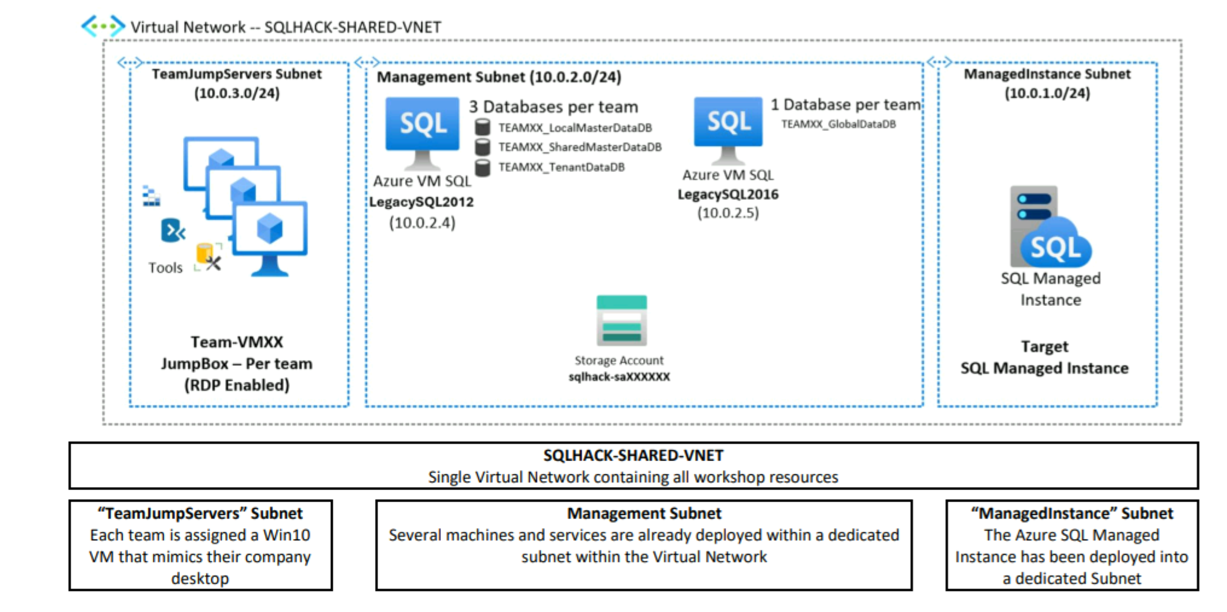


Lab Architecture

Slide 30
Format of the Azure SQL MIgrathon
Format
PDF’s for Walkthrough
Everybody works alone on the Labs by following the instructions
Directly asks any question to coaches in the room,, also after each lab during QnA.
Steps To Start / Credentials
Credentials will be shared in the chat in the coming slide.
Please open a “Private” Browser Window
Login to Azure Portal https://portal.azure.com with your portal credentials (Userxx@m365xx.onmicrosoft.com)
On the portal Click to Resource Groups > SQLHACK-TEAM_VMs > vm-TEAMxx
Click on Connect
Select “Bastion”
Provide Credentials (next Slide) for your VM and connect to your Jump Box
There you will find instructions for the Lab on the Desktop under “_SQLHACK_” folder
Change to “_SQLHACK_\LABS\01-Data_Migration” folder and follow the instructions in the .pdf files

Slide 31
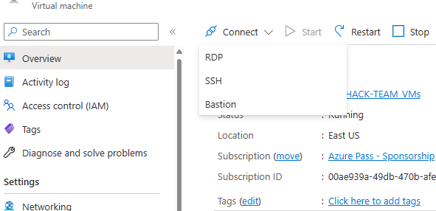
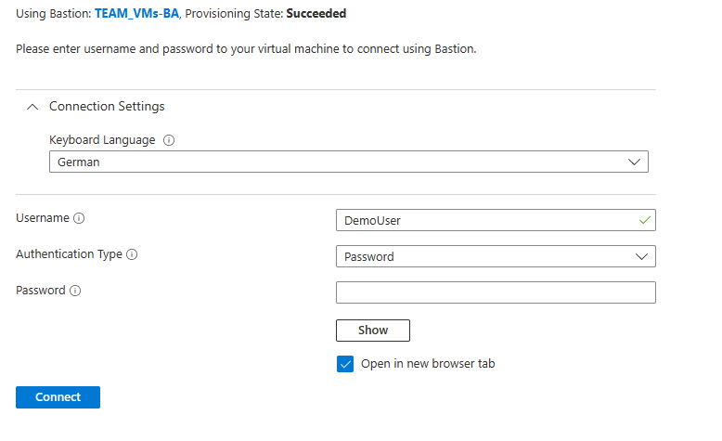
Login Data & Connect via Bastion
Andreas | sqlhackuser01@m365x90478194.onmicrosoft.com | &sqlhack@demo_01!
Cedomir | sqlhackuser02@m365x90478194.onmicrosoft.com | &sqlhack@demo_02!
Jörg | sqlhackuser03@m365x90478194.onmicrosoft.com | &sqlhack@demo_03!
Marco | sqlhackuser04@m365x90478194.onmicrosoft.com | &sqlhack@demo_04!
Michael | sqlhackuser05@m365x90478194.onmicrosoft.com | &sqlhack@demo_05!
David | sqlhackuser06@m365x90478194.onmicrosoft.com | &sqlhack@demo_06!
Swarali | sqlhackuser07@m365x90478194.onmicrosoft.com | &sqlhack@demo_07!
Om | sqlhackuser08@m365x90478194.onmicrosoft.com | &sqlhack@demo_08!
Alexandra | sqlhackuser09@m365x90478194.onmicrosoft.com | &sqlhack@demo_09!
Pooja | sqlhackuser10@m365x90478194.onmicrosoft.com | &sqlhack@demo_10!
Demouser
Demo@pass1234567

Slide 32
LAB 1: Assessing & Migrating SQL Server Databases to Azure SQL

Slide 33
Administering & Monitoring SQL Managed Instance

Slide 34
Administration, Monitoring and Tuning Azure SQL Database in the Cloud

Slide 35
Agenda
Core Database Administration Automation
Backups
Encryption
High-availability
Patching
Performance Monitoring and Troubleshooting
Troubleshooting approach – Running or Waiting?
Tools Reference
Azure Portal Overview
DMVs
Azure SQL Insights

Slide 36

Core Database Administration Automation
Backups
Encryption
High Availability
Patching

Slide 37
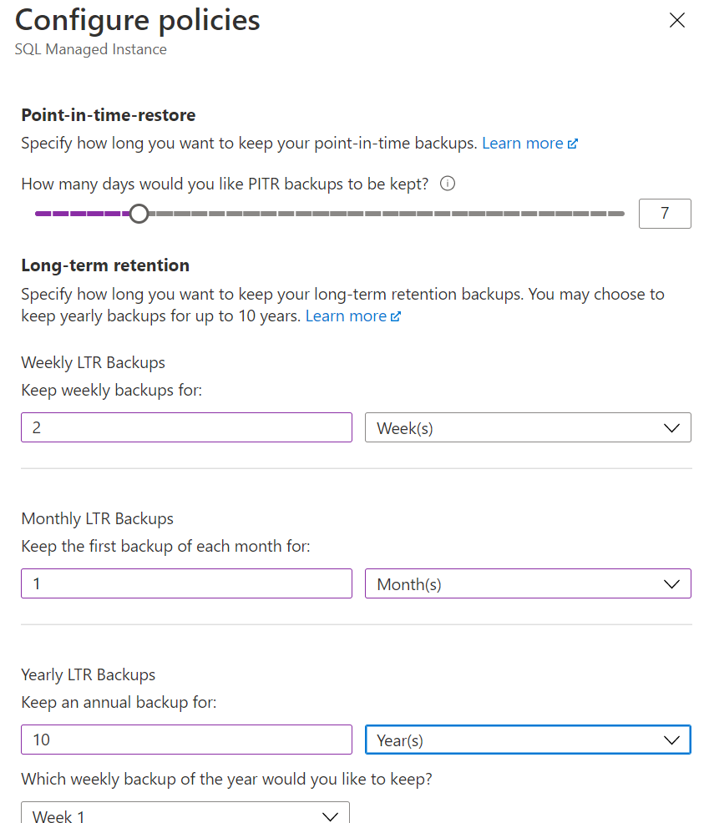
Backup / Restore Database
ZERO CONFIGURATION
Built-in with PaaS Service
Automated backup
Point In Time Restore – Retention 7 days per default
Can be configured
Point In Time restore – Up to 35 days
Long term retention up to 10 years
Manual commands like on Premise
RESTORE DATABASE TenantCRM
FROM URL='https://sqlhacksxxx.blob.core.windows.net/auditlogs/TenantCRM_xxxx.bak’
BACKUP DATABASE TenantCRM
TO URL='https://sqlhacksxxxxxxx.blob.core.windows.net/auditlogs/TenantCRM_xxx.bak'
WITH STATS, COPY_ONLY

Slide 38
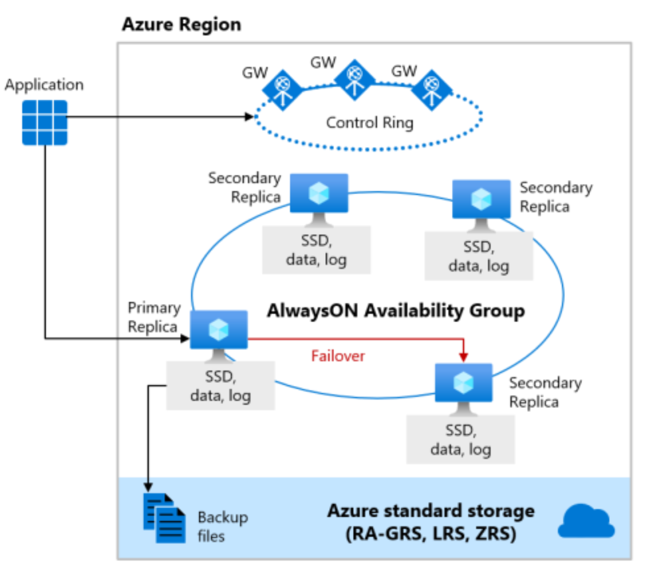
Core Database Administration Automation
High Availability
DBs/Managed Instances run on a technology similar to a 4-node SQL Server Always-On High Availability cluster
Geo-replication & Auto Failover Groups
Zero admin overhead with 99.99% availability
ZERO CONFIGURATION
Encryption
SQL Transparent Data Encryption on by default
Keys are either:
Managed by us
BYOK & stored in Azure Key Vault
Patching
Ever-green SQL – always patched, always v-Next
Compatibility Level SQL2008 DBs upwards
HA stand-by nodes are patched then fail-over & patch 4th node

Slide 39
Monitoring and Troubleshooting
Monitoring Tools Reference
Troubleshooting approach – Running or Waiting?

Slide 40
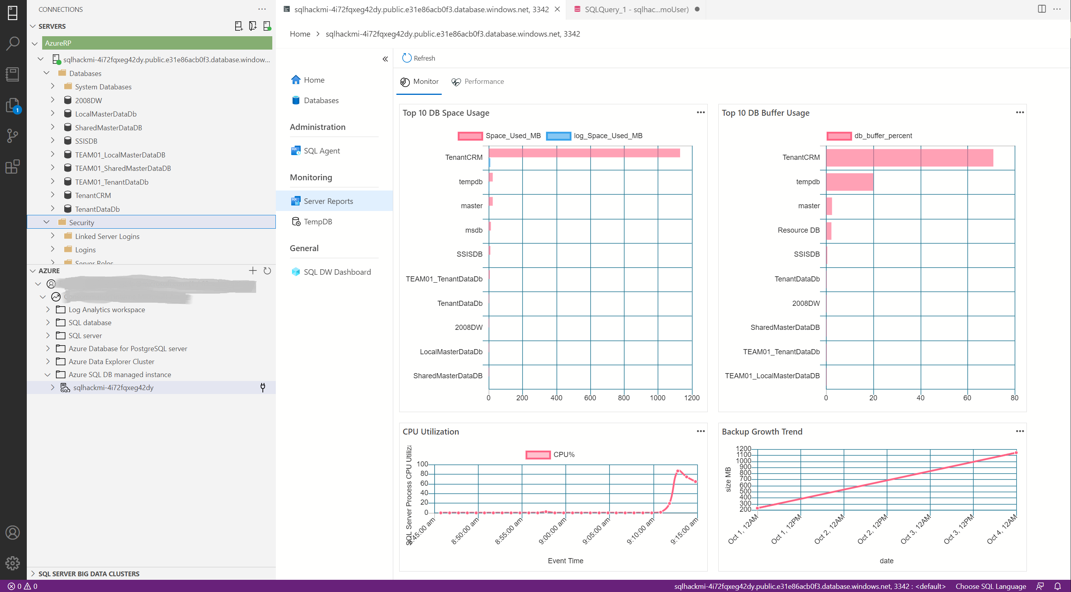
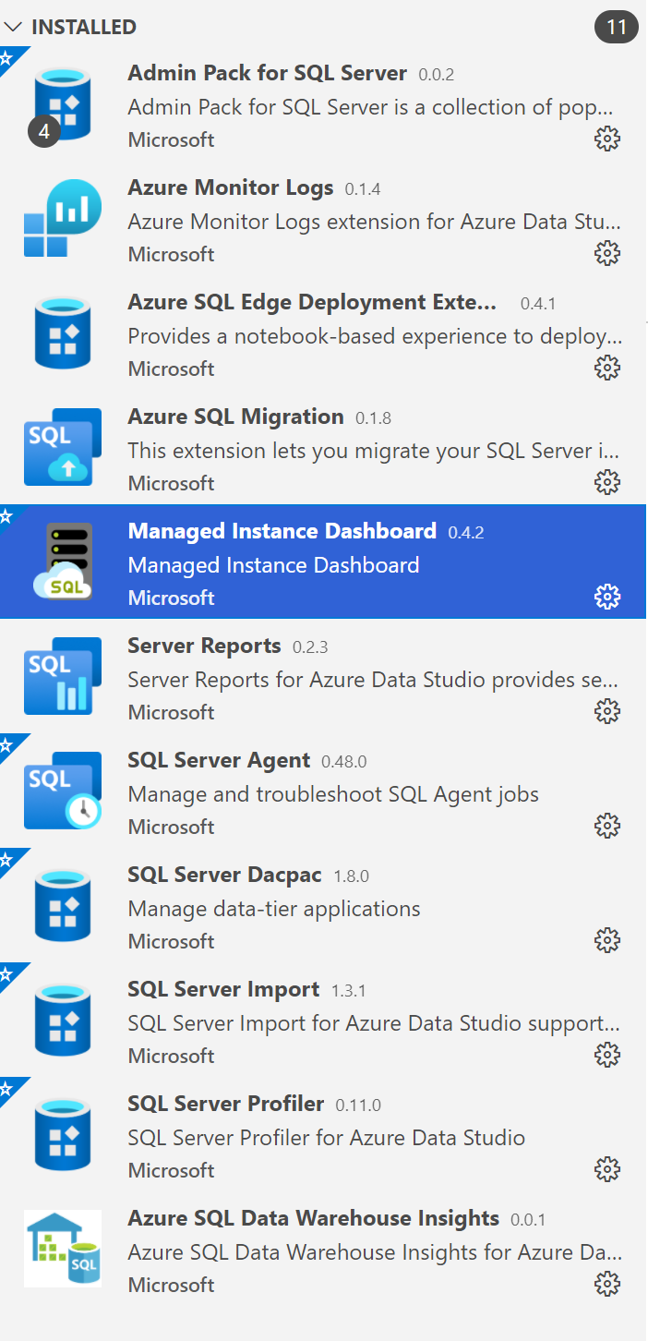
Administering Tools
Like OnPremises
Azure Data Studio
SQL Server Management Studio

Slide 41
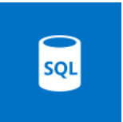
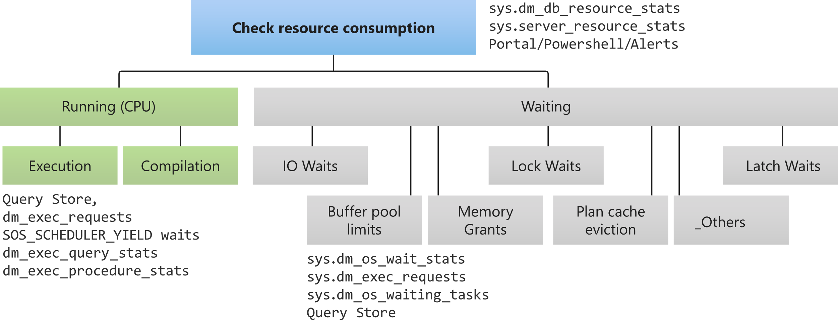
Troubleshooting approach – Running or Waiting?
Azure SQL

Slide 42
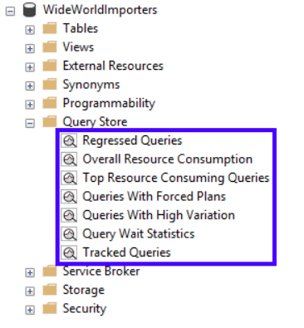
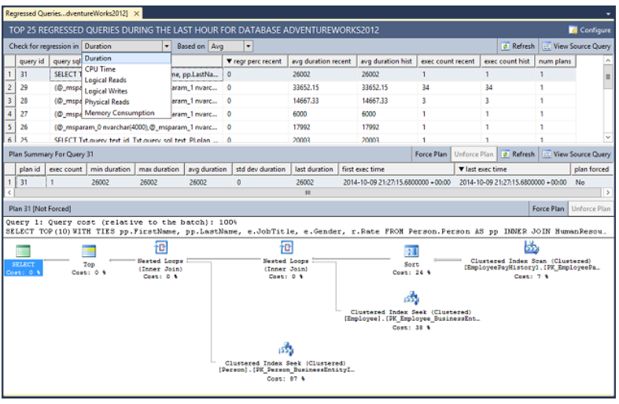
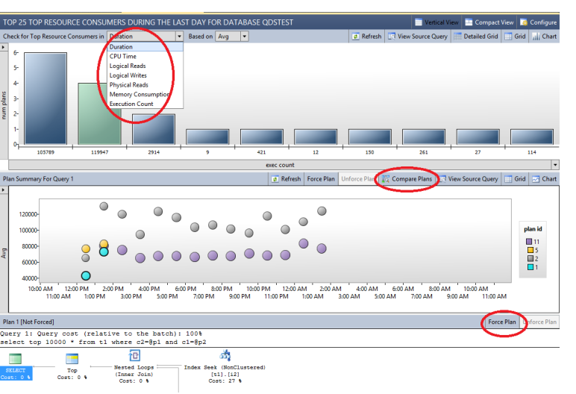
Query Store – Flightrecorder for the Admin

Slide 43
sys.dm_db_resource_stats
Returns CPU, Memory and IO consumption
Uses Query store
Stats captured every 15 seconds
History maintained for 1 hour
Data returned is percentage of maximum allowed limits for the service tier
If the % returned is consistently high, then performance tune or move to higher tier
This query returns the average and maximum values for CPU %, data and log I/O, and memory consumption over the last hour.
SELECT
AVG(avg_cpu_percent) AS 'Average CPU Utilization In %',
MAX(avg_cpu_percent) AS 'Maximum CPU Utilization In %',
AVG(avg_data_io_percent) AS 'Average Data IO In %',
MAX(avg_data_io_percent) AS 'Maximum Data IO In %',
AVG(avg_log_write_percent) AS 'Average Log Write I/O In %',
MAX(avg_log_write_percent) AS 'Maximum Log Write I/O In %',
AVG(avg_memory_usage_percent) AS 'Average Memory Usage In %',
MAX(avg_memory_usage_percent) AS 'Maximum Memory Usage In %'
FROM sys.dm_db_resource_stats;

Slide 44
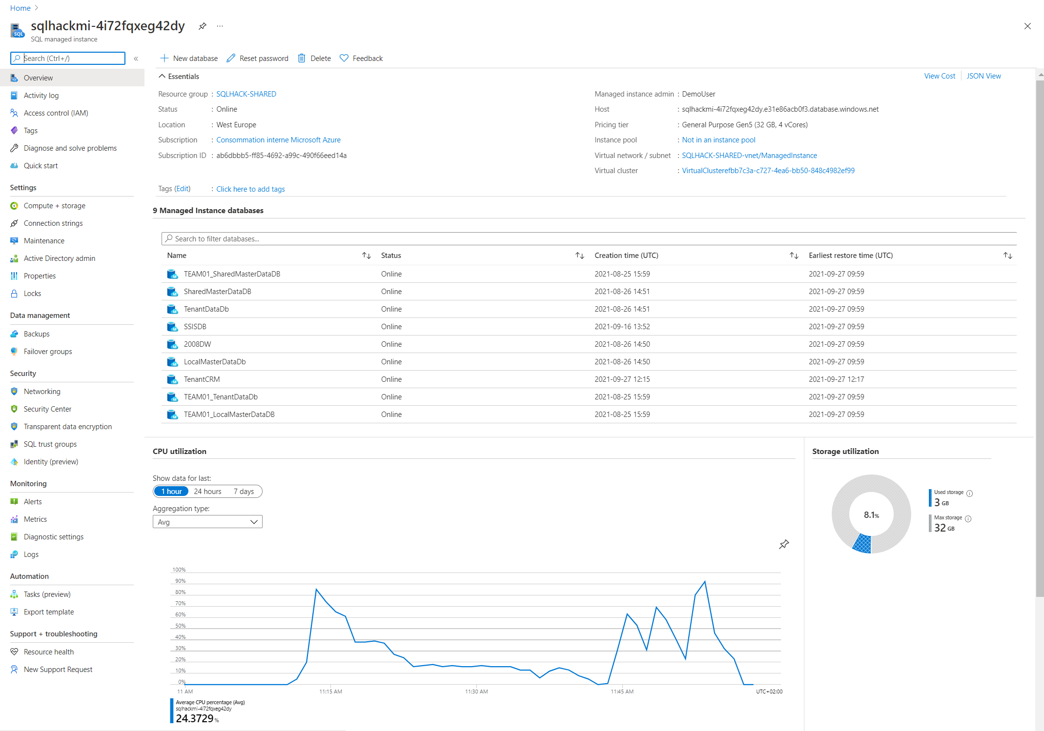
SQL Managed Instance Overview Blade – Azure Portal
Instance Details
Graphs can be drilled into
Alerts can be configured

Slide 45
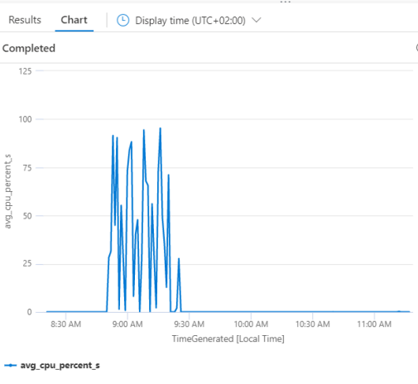



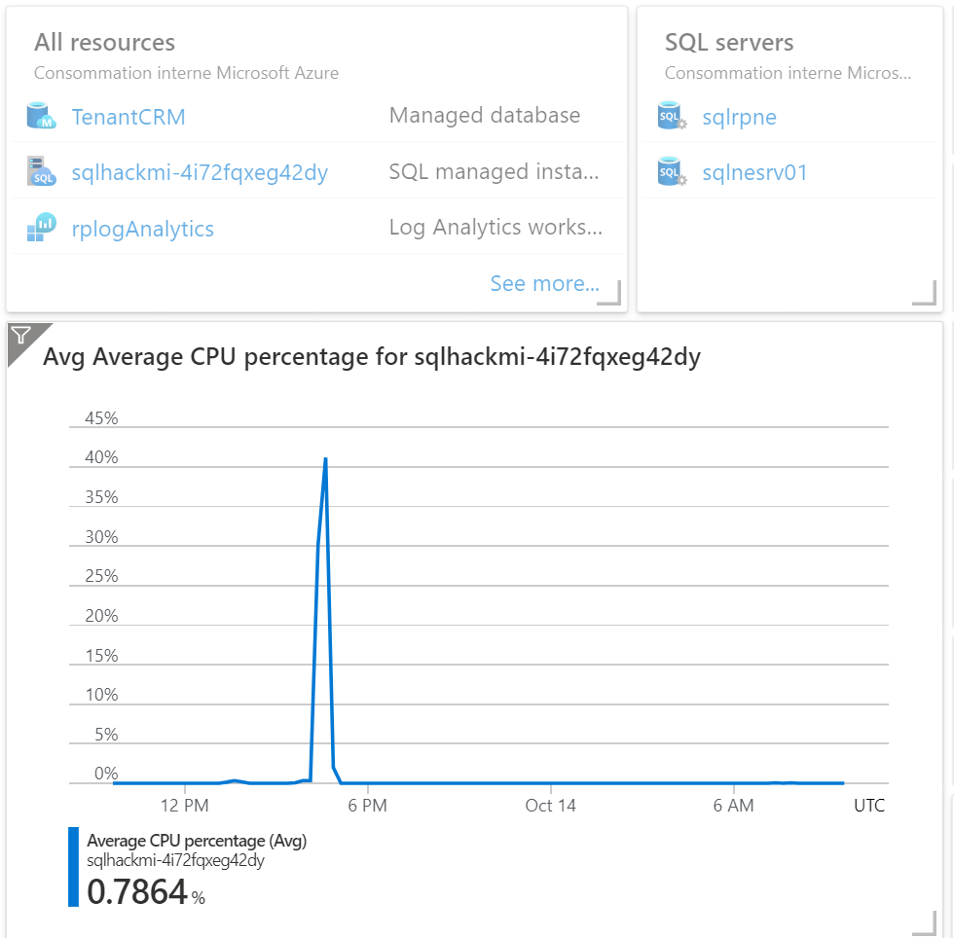

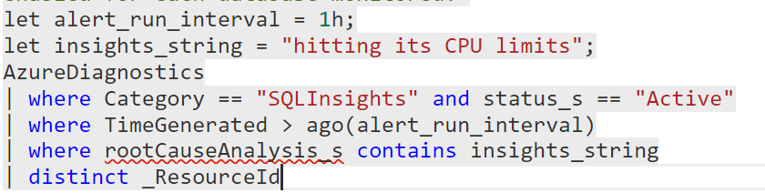

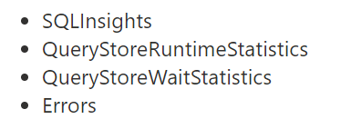
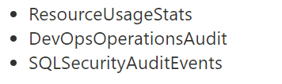
Diagnostics -> Log Analytics Workspace
Diagnostics telemetry
Alerts
Power BI
SQL Managed Instances
Diagnostics telemetry
Log Search
Dashboards
Partner tools
Diagnostics telemetry
Databases in managed instance
Log Analytics Overview

Slide 46
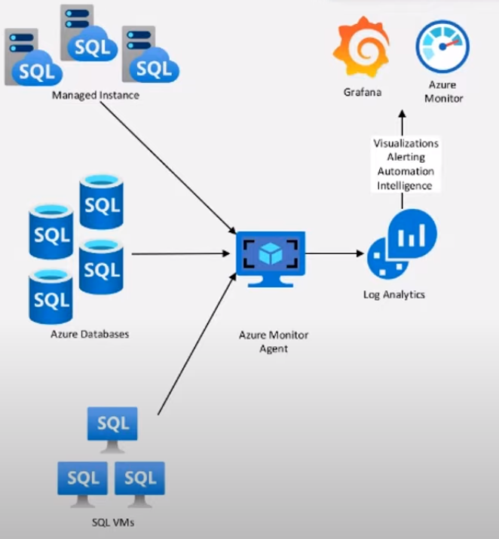
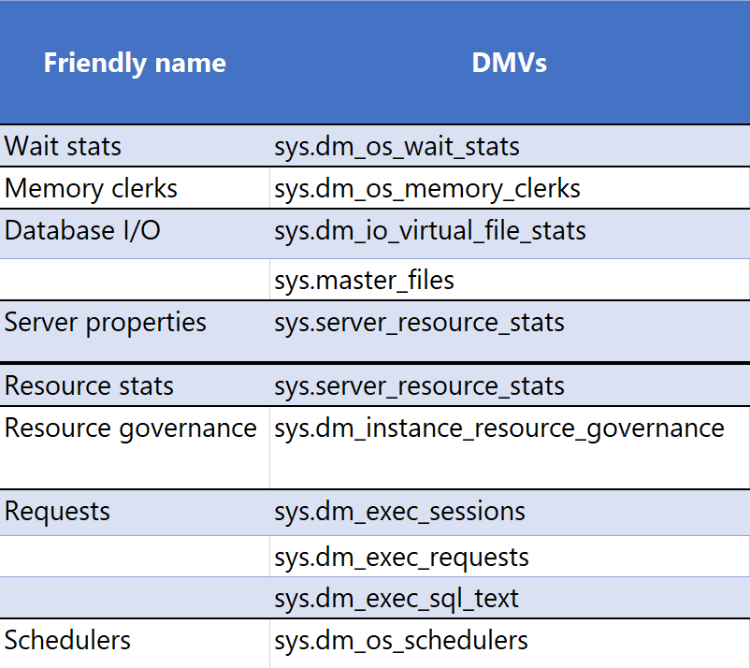
Azure Monitor SQL Insights : SQL Database, SQL MI, SQL VMs
Monitoring Azure SQL at scale
Single monitoring experience for your entire SQL estate
Native alerting and visualization functionality
Monitored metrics based on SQL DMVs
Customisable collect profile
Collected and push in Logs Analytics
SQL Insights Architecture
Monitor your SQL deployments with SQL insights (preview)

Slide 47
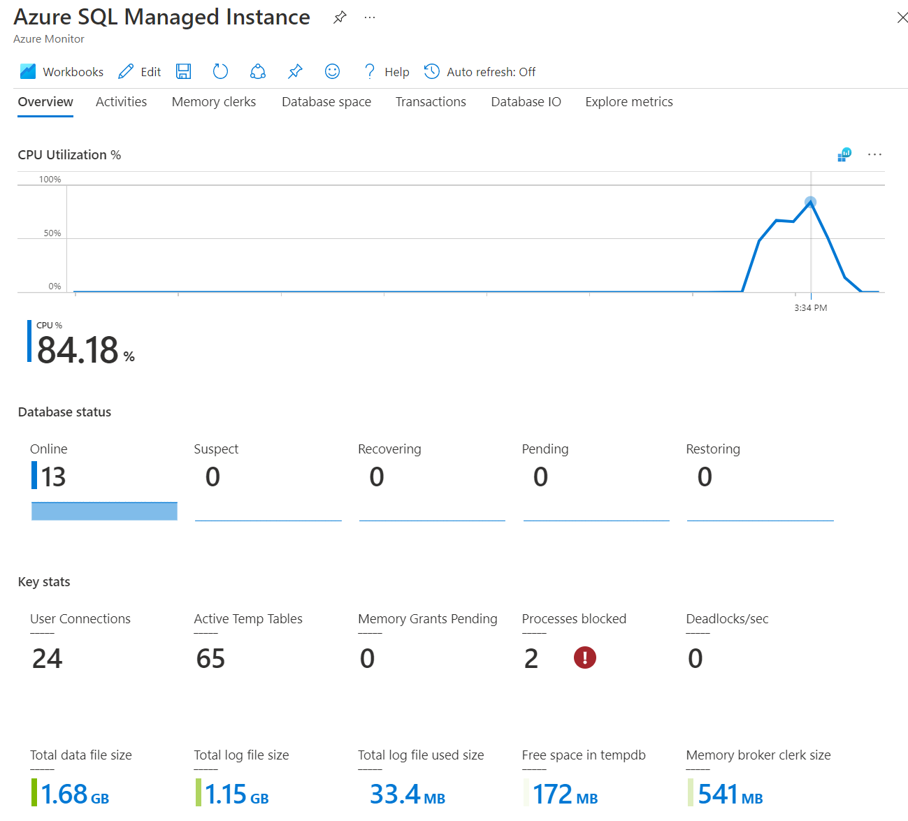
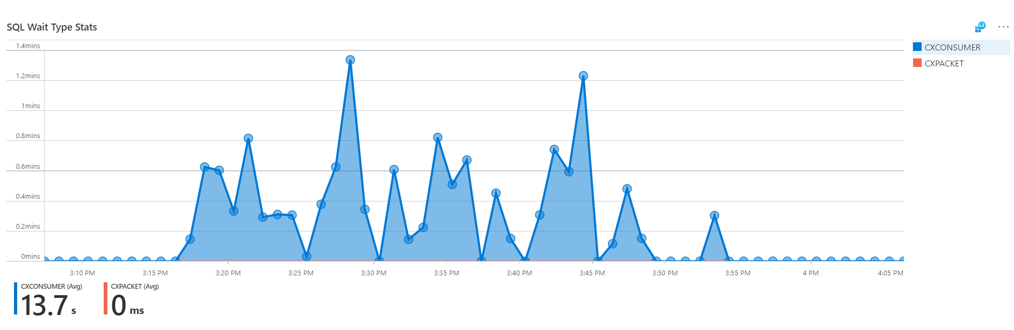
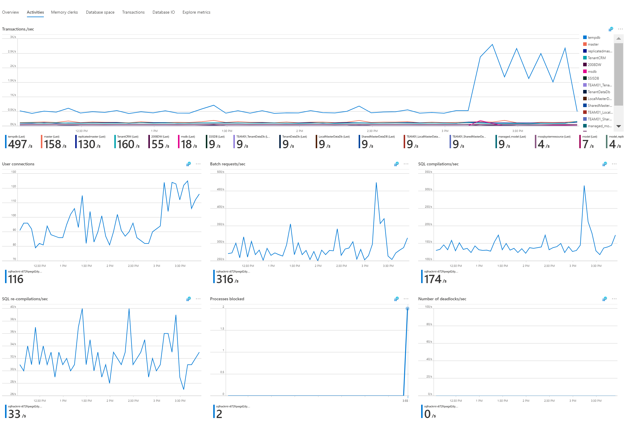
Azure Monitor SQL Insights : SQL Database, SQL MI, SQL VMs

Slide 48
Q&A

Slide 49
LAB 2: Administering & Monitoring Azure SQL Managed Instance

Slide 50
Securing SQL Managed Instance

Slide 51
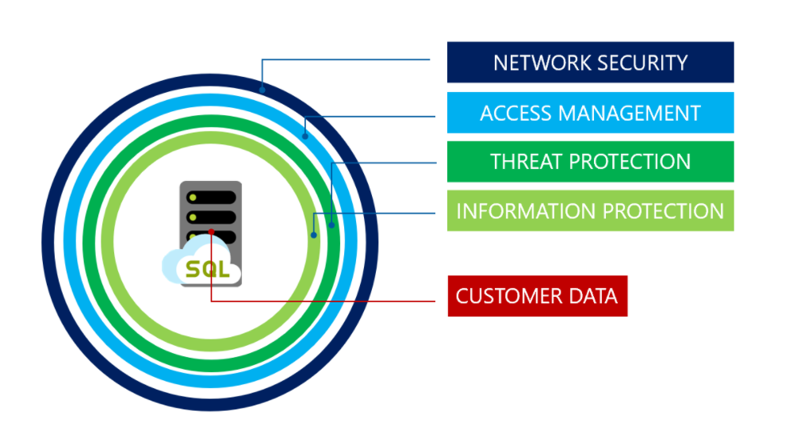
Create a strategy for securing Azure SQL
Notes:
Grundlagen zum Schutz der Datenmit Azure SQL Managed Instance
Sicherheitsstrategie folgt dem Defense-in-Depth-Schichtenmodell, das in der folgenden Abbildung dargestellt ist und von außen nach innen durchlaufen wird:
Netzwerksicherheit
Microsoft Azure SQL-Datenbank, Azure SQL Managed Instance und Azure Synapse Analytics bieten für Cloud- und Unternehmensanwendungen einen Dienst für relationale Datenbanken. Zum Schutz von Kundendaten verhindern Firewalls den Netzwerkzugriff auf den Server, bis der Zugriff explizit basierend auf der IP-Adresse oder dem Ursprung des Datenverkehrs im virtuellen Azure-Netzwerk gewährt wird.
Zugriffsverwaltung
Die Verwaltung von Datenbanken und Servern in Azure wird über die Rollenzuweisungen in Ihrem Portalbenutzerkonto gesteuert. Weitere Informationen zu diesem Artikel finden Sie unter Rollenbasierte Zugriffssteuerung in Azure im Azure-Portal.
Bedrohungsschutz
Zum Schutz der Kundendaten stellen SQL-Datenbank und SQL Managed Instance Funktionen für die Überwachung und Bedrohungserkennung bereit.
SQL Audit
Adv. Threat Protection
Informationsschutz und -verschlüsselung
TLS, TDE, Keys in Key Vault, data masking
Sicherheitsverwaltung
Vul. Assesssement
Die Sicherheitsrisikobewertung ist ein einfach zu konfigurierender Dienst, mit dem potenzielle Schwachstellen in der Datenbank ermittelt, nachverfolgt und behoben werden können. Damit soll die allgemeine Datenbanksicherheit proaktiv verbessert werden. Die Schwachstellenbewertung (VA) ist Teil des Microsoft Defender für SQL-Angebots
Datenermittlung und -klassifizierung
Datenerkennung und -klassifizierung (derzeit in der Vorschau) bietet grundlegende Funktionen, die in Azure SQL Database und SQL Managed Instance integriert sind, um sensible Daten in Ihren Datenbanken zu erkennen, zu klassifizieren und zu kennzeichnen.

Slide 52



Implement Authentication/ Access strategy
Implement Data protection strategy
Secure the Network
Monitor, log & audit
Manage Security
VNET injection
for Managed Instances
Azure Active Directory
Encryption-in-use
(Always Encrypted)
SQL Audit
Azure defender for SQL
Private Link
SQL & Windows Authentication
Encryption-at-rest
(TDE)
Audit Integration with
Log Analytics and
Event Hubs
Advanced Threat
Detection
Firewall Rules, NSG
Multi-Factor
Authentication
Encryption-in-flight
(TLS)
Data Discovery &
Classification
Role-based
Access Control (RBAC)
Control Plane
Vulnerability
Assessment
Dynamic Data Masking
Row/Column-level
security
Notes:
Der Dienst "SQL Managed Instance" " innerhalb des virtuellen Netzwerks befinden. Dies wird als "VNET-Injektion" bezeichnet weil es den Dienst direkt im VNET bereitstellt.
In der Regel weisen Sie jedem dieser Dienste ein eigenes Subnetz zu, ohne dass sich weitere Elemente darin befinden, um Interoperabilitätsprobleme zu vermeiden.
######################################
Der Virtual Network (VNet)-Dienstendpunkt bietet eine sichere und direkte Verbindung mit Azure-Diensten über eine optimierte Route über das Azure-Backbonenetzwerk. Endpunkte ermöglichen es Ihnen, Ihre kritischen Ressourcen von Azure-Diensten auf Ihre virtuellen Netzwerke zu beschränken und so zu schützen. Dienstendpunkte ermöglichen es privaten IP-Adressen im VNet, den Endpunkt eines Azure-Diensts zu erreichen, ohne dass eine öffentliche IP-Adresse im VNet benötigt wird.
Private Link ermöglicht die Verbindungsherstellung mit verschiedenen PaaS-Diensten in Azure über einen privaten Endpunkt.
Ein privater Endpunkt ist eine private IP-Adresse in einem bestimmten VNET und Subnetz
Microsoft empfiehlt die Verwendung von Azure Private Link für den sicheren und privaten Zugriff auf SQL MI / Dienste, die auf der Azure-Plattform gehostet werden.
Der Nuancenunterschied zwischen "VNET-Injektion" und "Privater Link" besteht darin,
VNET-Injektion wird für Ressourcen verwendet wird, die Ihnen zugewiesen sind ( SQL Managed Instance, ...)
und der Privater Link für Dienste, die darunter liegende Ressourcen gemeinsam nutzen (Azure SQL DB, Azure Storage, ...).
Auf diese Weise können Sie auch eine Verbindung mit Diensten in einem hybriden Integrationsszenario herstellen.
######################################
IP-Firewallregeln
IP-Firewallregeln gewähren den Datenbankzugriff auf der Grundlage der Ursprungs-IP-Adresse der jeweiligen Anforderung. Weitere Informationen finden Sie unter Übersicht über Firewallregeln für Azure SQL-Datenbank und Azure Synapse Analytics.
Firewallregeln für virtuelle Netzwerke
VNET-Dienstendpunkte erweitern Ihre VNET-Konnektivität über den Azure-Backbone hinaus und ermöglichen Azure SQL-Datenbank, das Subnetz des virtuellen Netzwerks zu identifizieren, aus dem der Datenverkehr stammt. Wenn Sie Datenverkehr an Azure SQL-Datenbank zulassen möchten, verwenden Sie die SQL-Diensttags, um ausgehenden Datenverkehr über Netzwerksicherheitsgruppen zu ermöglichen.
Netzwerksicherheitsgruppen
Azure-Netzwerksicherheitsgruppe verwenden, um Netzwerkdatenverkehr zwischen Azure-Ressourcen in einem virtuellen Azure-Netzwerk zu filtern. Eine Netzwerksicherheitsgruppe enthält Sicherheitsregeln, die eingehenden Netzwerkdatenverkehr an verschiedene Typen von Azure-Ressourcen oder ausgehenden Netzwerkdatenverkehr von diesen zulassen oder verweigern. Für jede Regel können Sie die Quelle, das Ziel, den Port und das Protokoll angeben.

Slide 53
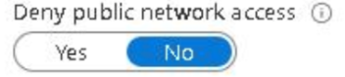
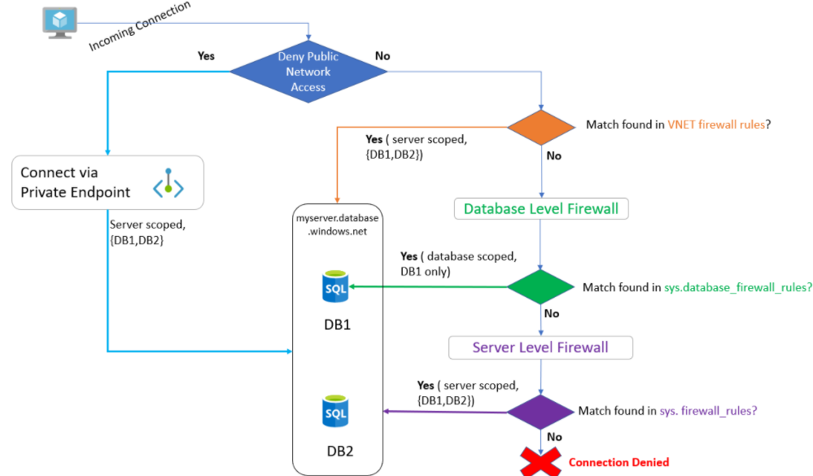
Network Security – Azure SQL Database
NO
Then you need to set IP or Virtual Network Firewall rules
Yes
Then you need to configure Private Link
Connections are allowed only from virtual network
Use cases for Private Link
From the same Vnet
Peered Vnet in same region
Vnet to Vnet connection across regions
From On-premise via
Express route
Private peering
VPN tunnel
Notes:
IP-Firewallregeln
IP-Firewallregeln gewähren den Datenbankzugriff auf der Grundlage der Ursprungs-IP-Adresse der jeweiligen Anforderung. Weitere Informationen finden Sie unter Übersicht über Firewallregeln für Azure SQL-Datenbank und Azure Synapse Analytics.
Firewallregeln für virtuelle Netzwerke
VNET-Dienstendpunkte erweitern Ihre VNET-Konnektivität über den Azure-Backbone hinaus und ermöglichen Azure SQL-Datenbank, das Subnetz des virtuellen Netzwerks zu identifizieren, aus dem der Datenverkehr stammt. Wenn Sie Datenverkehr an Azure SQL-Datenbank zulassen möchten, verwenden Sie die SQL-Diensttags, um ausgehenden Datenverkehr über Netzwerksicherheitsgruppen zu ermöglichen.
Mithilfe von VNET-Regeln kann Azure SQL-Datenbank nur Verbindungen akzeptieren, die von ausgewählten Subnetzen innerhalb eines virtuellen Netzwerks stammen.

Slide 54
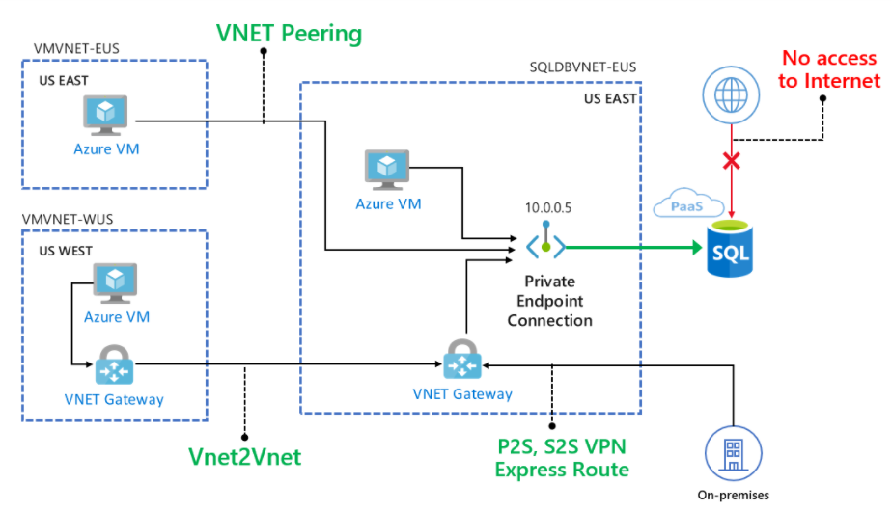
Network Security - Private Link for Azure SQL Database
Use cases for Private Link
From the same Vnet
Peered Vnet in same region
Vnet to Vnet connection across regions
From On-premise via
Express route
Private peering
VPN tunnel
Notes:
Private Link ermöglicht die Verbindungsherstellung mit verschiedenen PaaS-Diensten in Azure über einen privaten Endpunkt. Eine Liste der PaaS-Dienste, die die Private Link-Funktion unterstützen, finden Sie in der Private Link-Dokumentation. Ein privater Endpunkt ist eine private IP-Adresse in einem bestimmten VNET und Subnetz.
Private Endpunkte können über das Azure-Portal, mithilfe von PowerShell oder über die Azure CLI erstellt werden:
Portal
PowerShell
BEFEHLSZEILENSCHNITTSTELLE (CLI)
Nachdem der Netzwerkadministrator den privaten Endpunkt (PE) erstellt hat, kann der SQL-Administrator die private Endpunktverbindung (Private Endpoint Connection, PEC) mit SQL-Datenbank verwalten.
Deaktivieren Sie den öffentlichen Zugriff auf Ihren logischen Server
Gehen Sie für dieses Szenario davon aus, dass Sie den gesamten öffentlichen Zugriff auf Ihren logischen Server deaktivieren und nur Verbindungen aus Ihrem virtuellen Netzwerk zulassen möchten.
Stellen Sie zunächst sicher, dass Ihre Verbindungen mit privaten Endpunkten aktiviert und konfiguriert sind. So deaktivieren Sie anschließend den öffentlichen Zugriff auf Ihren logischen Server
Testen der Konnektivität mit SQL-Datenbank über einen virtuellen Azure-Computer im gleichen virtuellen Netzwerk
In diesem Szenario wird davon ausgegangen, dass Sie einen virtuellen Azure-Computer (VM) erstellt haben, auf dem eine aktuelle Version von Windows im gleichen virtuellen Netzwerk wie der private Endpunkt ausgeführt wird.

Slide 55



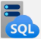

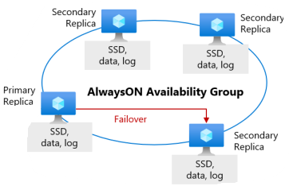
Network Security – SQL Managed Instance
Web app (public IP)
IaaS hosted app
App subnet
VNet 2
VPN/Express route gateway
Private
Connection
VNet-to-VNet
Public Connection (Opional)
Network isolation (customer VNET)
SQL instance
Tenant isolation (virtual private cluster)
MI Subnet
VNet 1
On-premises
Notes:
Bei SQL Managed Instance wird im virtuellen Azure-Netzwerk und dem für verwaltete Instanzen dedizierten Subnetz eine Instanz platziert. Die Bereitstellung bietet Folgendes:
Eine sichere IP-Adresse im lokalen virtuellen Netzwerk (VNet).
Die Möglichkeit, eine Verbindung von einem lokalen Netzwerk mit SQL Managed Instance herzustellen.
Die Möglichkeit, eine Verbindung von SQL Managed Instance mit einem Verbindungsserver oder einem anderen lokalen Datenspeicher herzustellen.
Die Möglichkeit, eine Verbindung von SQL Managed Instance mit Azure-Ressourcen herzustellen.
Mit der Featurewelle vom November 2022 wurden Änderungen an der standardmäßigen Konnektivitätsstruktur von SQL Managed Instance eingeführt.
Die Datenebene wird aus Gründen der Kompatibilität, Konnektivität und Netzwerkisolation im Subnetz des Kunden bereitgestellt. Der Zugriff auf die Datenebene erfolgt in der Regel über den lokalen VNet-Endpunkt. Die Datenebene erfordert Azure-Dienste wie Azure Storage, Azure Active Directory (Azure AD) für die Authentifizierung und Telemetriesammlungsdienste. Aus Subnetzen mit SQL Managed Instance stammender Datenverkehr wird an diese Dienste weitergeleitet.

Slide 56
Implement Authentication/
Access strategy
Implement Data protection strategy
Secure the Network
Monitor, log & audit
Manage Security
VNET injection
for managed instances
Azure Active Directory
Encryption-in-use
(Always Encrypted)
SQL Audit
Azure defender for SQL
Private Link
SQL & Windows Authentication
Encryption-at-rest
(TDE)
Audit Integration with
Log Analytics and
Event Hubs
Advanced Threat
Detection
Firewall Rules, NSG
Multi-Factor
Authentication
Encryption-in-flight
(TLS)
Data Discovery &
Classification
Role-based
Access Control (RBAC) Control Plane
Dynamic Data Masking
Vulnerability
Assessment
Row/Column-level
security

Slide 57
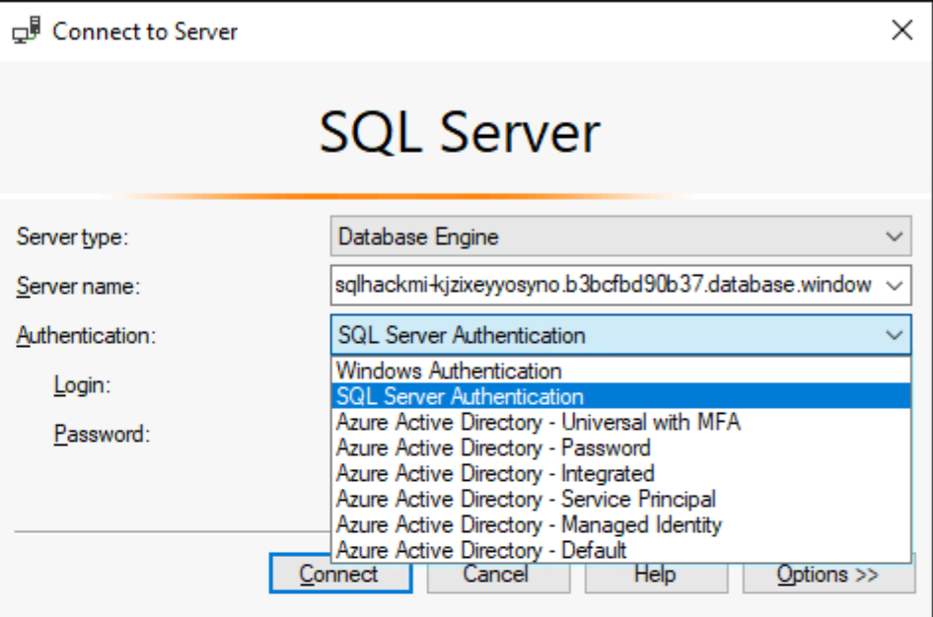
Azure SQL / Authentication Options
SQL Server Authentication
User/password
Windows Authentication on Azure SQL Managed Instance
Kerberos Authentication for Azure AD enabled Windows Authentication for AAD principles
Azure Active Directory Authentication Methods
User/password
Integrated (Single Sign-On) for federated directories
Universal/Interactive Multi-Factor Authentication
Service Principal
Managed Identity
Notes:
Authentifizierungsoptionen
Es gibt zwei nicht interaktive Authentifizierungsmodelle für Azure AD, die in zahlreichen verschiedenen Anwendungen (ADO.NET, JDCB, ODC usw.) verwendet werden können. Bei diesen beiden Methoden werden niemals Popupdialogfelder angezeigt:
Azure Active Directory - Password
Azure Active Directory - Integrated
Die folgende interaktive Methode unterstützt auch Azure AD Multi-Factor Authentication (MFA):
Azure Active Directory - Universal with MFA
Azure AD MFA bietet Schutz für den Zugriff auf Daten sowie Anwendungen und erfüllt gleichzeitig Benutzeranforderungen nach einem einfachen Anmeldevorgang. Diese Lösung ermöglicht eine sichere Authentifizierung über eine Reihe einfacher Überprüfungsoptionen: Telefonanruf, SMS, Smartcards mit PIN oder Benachrichtigung in einer mobilen App. Benutzer können ihre bevorzugte Methode wählen. Bei der interaktiven MFA mit Azure AD kann ein Popupdialogfeld zur Überprüfung geöffnet werden.
From <https://learn.microsoft.com/de-de/azure/azure-sql/database/authentication-mfa-ssms-overview?view=azuresql>
Verwenden der mehrstufigen Azure Active Directory-Authentifizierung - Azure SQL Database & SQL Managed Instance & Azure Synapse Analytics | Microsoft Learn
SSMS und SqlPackage sind die einzigen Tools, die derzeit für die MFA über die universelle Active Directory-Authentifizierung aktiviert sind.
From <https://learn.microsoft.com/de-de/azure/azure-sql/database/authentication-mfa-ssms-overview?view=azuresql>
Einrichten der Windows-Authentifizierung für Azure SQL Managed Instance mit Azure Active Directory und Kerberos - Azure SQL Managed Instance | Microsoft Learn

Slide 58
Implement Authentication/ Access strategy
Implement Data protection strategy
Secure the Network
Monitor,
log & audit
Manage Security
VNET injection
for managed instances
Azure Active Directory
Encryption-in-use
(Always Encrypted)
SQL Audit
Azure defender for SQL
Private Link
SQL & Windows Authentication
Encryption-at-rest
(TDE)
Audit Integration with
Log Analytics and
Event Hubs
Advanced Threat
Detection
Firewall Rules, NSG
Multi-Factor
Authentication
Encryption-in-flight
(TLS)
Data Discovery &
Classification
Role-based
Access Control (RBAC)
Control Plane
Dynamic Data Masking
Vulnerability
Assessment
Row/Column-level
security
Notes:
Always Encrypted allows clients to encrypt sensitive data inside client applications and
never reveal the encryption keys to the Database Engine.
This provides a separation between those who own the data and can view it,
--- and those who manage the data but should have no access –like admins.
TDE - Encrytiopn at rest
TLS - Encryption at transit.
Dynamic Data Masking is a policy-based security feature
that helps to limit the exposure of data in a database by returning masked data to non-privileged users who run queries over designated database fields.

Slide 59
Implement Authentication/ Access strategy
Implement Data protection strategy
Secure the Network
Monitor,
log & audit
Manage Security
VNET injection
for managed instances
Azure Active Directory
Encryption-in-use
(Always Encrypted)
SQL Audit
Azure defender for SQL
Private Link
SQL & Windows Authentication
Encryption-at-rest
(TDE)
Audit Integration with
Log Analytics and
Event Hubs
Advanced Threat
Detection
Firewall Rules, NSG
Multi-Factor
Authentication
Encryption-in-flight
(TLS)
Data Discovery &
Classification
Role-based
Access Control (RBAC)
Control Plane
Dynamic Data Masking
Vulnerability
Assessment
Row/Column-level
security
Notes:
Bei der Überwachung von SQL-Datenbank und SQL Managed Instance werden Datenbankaktivitäten nachverfolgt, und Sie erhalten Unterstützung bei der Einhaltung von Sicherheitsstandards, indem Datenbankereignisse in einem Überwachungsprotokoll in einem Azure Storage-Konto des Kunden aufgezeichnet werden. Dank der Überwachung können Benutzer die fortlaufenden Datenbankaktivitäten überwachen und die Verlaufsaktivität analysieren und untersuchen, um potenzielle Bedrohungen oder vermutete Missbrauchsfälle und Sicherheitsverletzungen zu identifizieren. Weitere Informationen finden Sie in den ersten Schritten unter Überwachung von SQL-Datenbank.
From <https://learn.microsoft.com/de-de/azure/azure-sql/database/security-overview?view=azuresql>
Bei der Azure SQL Managed Instance-Überwachung werden Datenbankereignisse nachverfolgt und in ein Überwachungsprotokoll in Ihrem Azure-Speicherkonto geschrieben. Die Überwachung ermöglicht außerdem Folgendes:
Sie kann Ihnen dabei helfen, die gesetzlichen Bestimmungen einzuhalten, die Datenbankaktivität zu verstehen und Einblicke in Abweichungen und Anomalien zu erhalten, die auf geschäftsspezifische Bedenken oder mutmaßliche Sicherheitsverstöße hinweisen können.
Sie ermöglicht und unterstützt die Einhaltung von Standards, garantiert diese aber nicht. Weitere Informationen finden Sie im Microsoft Azure Trust Center, wo die aktuelle Liste von Konformitätszertifizierungen für SQL Managed Instance angezeigt wird.
Einrichten der Überwachung für Ihren Server in Azure Storage
SQL Managed Instance-Überwachung - Azure SQL Managed Instance | Microsoft Learn
Log Analytics in Azure Monitor
Log Analytics ist ein Tool im Azure-Portal, mit dem Protokollabfragen für Daten im Azure Monitor-Protokollspeicher bearbeitet und ausgeführt werden.
Sie können eine einfache Abfrage schreiben, die eine Reihe von Datensätzen zurückgibt, und dann Funktionen von Log Analytics zum Sortieren, Filtern und Analysieren verwenden. Sie können auch eine erweiterte Abfrage schreiben, um eine statistische Analyse durchzuführen und die Ergebnisse in einem Diagramm zu visualisieren, und auf diese Weise einen bestimmten Trend erkennen.
Unabhängig davon, ob Sie die Ergebnisse Ihrer Abfragen interaktiv verwenden oder mit anderen Azure Monitor-Funktionen wie Protokollabfragewarnungen oder Arbeitsmappen nutzen, ist Log Analytics das Tool, das Sie zum Schreiben und Testen der Abfragen verwenden.
Beziehung zu Azure Data Explorer
Wenn Sie bereits mit der Azure Data Explorer-Webbenutzeroberfläche gearbeitet haben, sollte Ihnen Log Analytics bekannt vorkommen. Der Grund dafür ist, dass Log Analytics auf Azure Data Explorer basiert und die gleiche Kusto-Abfragesprache verwendet.

Slide 60
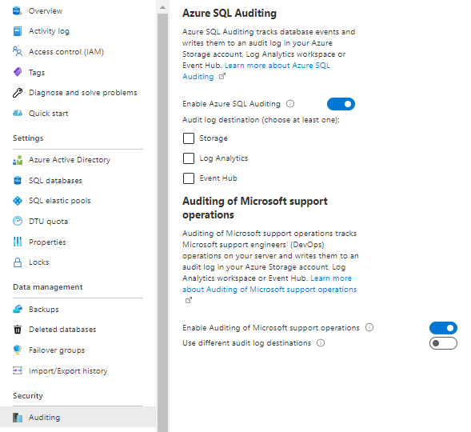
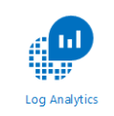
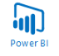
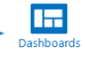

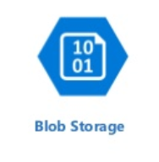
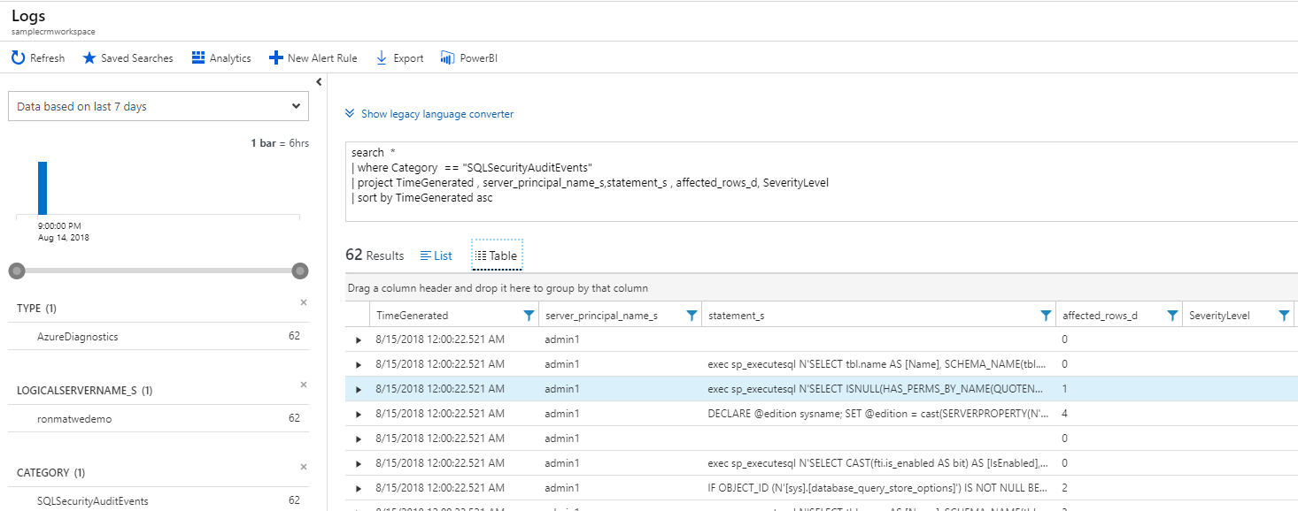
SQL Auditing
SQL audit logs can reside in
Azure Storage account
Azure Log Analytics
Azure Event Hubs
Rich set of analysis in e. g. Log Analytics
Investigating security alerts
Tracking access to sensitive data
Audit Log
Azure SQL Database
Developer
(1) Turn on SQL Auditing
(2) Analyze audit log
Notes:
DIFFERENT AUDIT POLICIES
Azure SQL DBs
BATCH_COMPLETED_GROUP
SUCCESSFUL_DATABASE_AUTHENTICATION_GROUP
FAILED_DATABASE_AUTHENTICATION_GROUP
Azure MI
ResourceUsageStats
DevOpsOperationAudit
SQLSecurityAuditEvents
Datenermittlung und -klassifizierung
Die Datenermittlung und -klassifizierung ist in Azure SQL-Datenbank, Azure SQL Managed Instance und Azure Synapse Analytics integriert. Sie bietet grundlegende Funktionen zum Ermitteln, Klassifizieren und Bezeichnen vertraulicher Daten in Ihren Datenbanken und zum Erstellen von Berichten zu diesen Daten.
Zu den vertraulichsten Daten gehören Geschäfts-, Finanz-, Gesundheits- und personenbezogene Informationen. Sie kann für Folgendes als Infrastruktur gelten:
Unterstützung bei der Einhaltung von Standards für den Datenschutz und von gesetzlichen Bestimmungen
Verschiedene Sicherheitsszenarien, z. B. Überwachung vertraulicher Daten
Steuern des Zugriffs auf und Härten der Sicherheit von Datenbanken mit vertraulichen Daten
Was ist die Datenermittlung und -klassifizierung?
Die Datenermittlung und -klassifizierung unterstützt derzeit die folgenden Funktionen:
Ermittlung und Empfehlungen: Das Klassifizierungsmodul scannt Ihre Datenbank und identifiziert Spalten, die unter Umständen vertrauliche Daten enthalten. Es bietet dann eine einfache Möglichkeit, die Ergebnisse zu überprüfen und die empfohlenen Klassifizierungen über das Azure-Portal anzuwenden.
Bezeichnung: Sie können Klassifizierungsbezeichnungen nach der Vertraulichkeit der Daten dauerhaft auf Spalten anwenden, indem Sie neue Metadatenattribute nutzen, die der SQL Server-Datenbank-Engine hinzugefügt wurden. Diese Metadaten können dann für Überwachungsszenarien auf Grundlage der Vertraulichkeit genutzt werden.
Vertraulichkeit von Abfrageergebnissen: Die Vertraulichkeit von Abfrageergebnissen wird zu Überwachungszwecken in Echtzeit berechnet.
Transparenz: Der Klassifizierungsstatus der Datenbank kann in einem detaillierten Dashboard im Azure-Portal angezeigt werden. Darüber hinaus können Sie einen Bericht (im Excel-Format) herunterladen, der für Compliance- und Überwachungszwecke und andere Anforderungen verwendet werden kann.

Slide 61
Implement Authentication/ Access strategy
Implement Data protection strategy
Secure the Network
Monitor, log & audit
Manage Security
VNET injection
for managed instances
Azure Active Directory
Encryption-in-use
(Always Encrypted)
SQL Audit
Microsoft Defender for Cloud
Private Link
SQL & Windows Authentication
Encryption-at-rest
(TDE)
Audit Integration with
Log Analytics and
Event Hubs
Advanced Threat
Detection
Firewall Rules, NSG
Multi-Factor
Authentication
Encryption-in-flight
(TLS)
Vulnerability
Assessment
Role-based
Access Control (RBAC)
Control Plane
Data Discovery &
Classification
Dynamic Data Masking
Row/Column-level
security

Slide 62
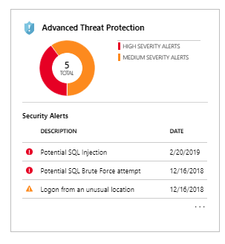
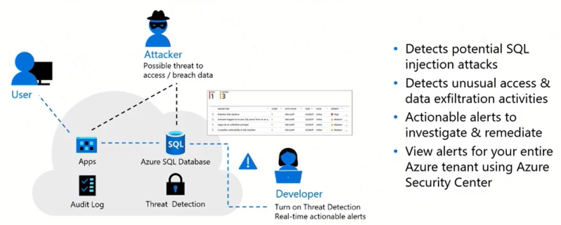
Manage Security Advanced Threat Protection with Azure SQL Defender
Notes:
Erweiterter Schutz vor Bedrohungen
Advanced Threat Protection analysiert Ihre Logs/ Protokolle auf ungewöhnliches Verhalten und potenziell schädliche Zugriffs- oder Offenlegungsversuche bei Datenbanken.
Warnungen werden für verdächtige Aktivitäten wie SQL-Injektion, potenzielle Dateninfiltration und Brute-Force-Angriffe oder für Anomalien in den Zugriffsmustern erstellt, um Berechtigungserweiterungen und die Verwendung gefährdeter Anmeldeinformationen zu erfassen.
Warnungen in Microsoft Defender für Cloud anzeigen.
Details zu verdächtigen Aktivitäten und Empfehlungen für weitere Untersuchungen sowie zu Aktionen, mit denen das Risiko minimiert werden kann. Advanced Threat Protection kann pro Server für eine zusätzliche Gebühr aktiviert werden. Weitere Informationen finden Sie unter Erste Schritte mit Advanced Threat Protection von SQL-Datenbank.

Slide 63
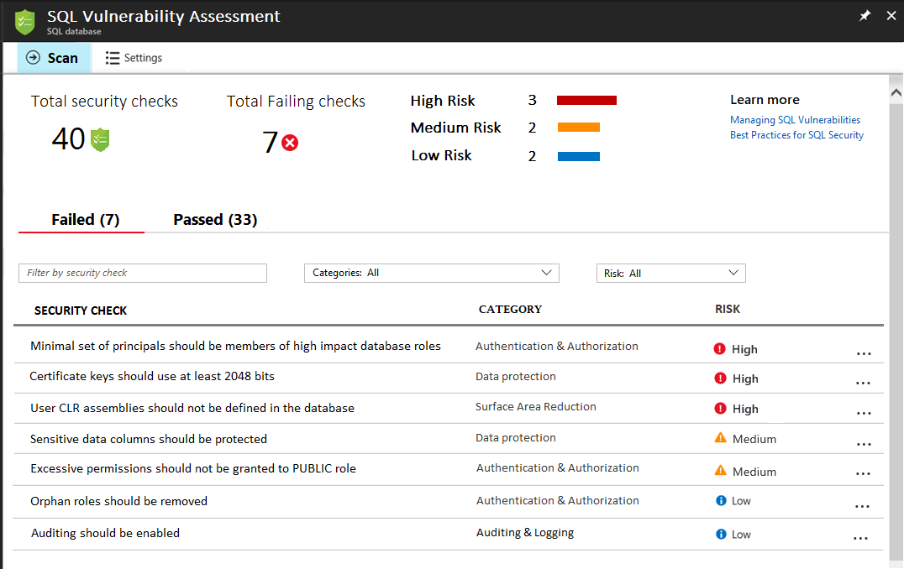
Manage Security Vulnerability Assessment with Azure SQL Defender
Identify security misconfigurations
Actionable remediation steps
Security baseline tuned to your environment
Manual/periodic scans
Coherent reports for auditors
Notes:
Vulnerability Assessment
Was ist die SQL-Sicherheitsrisikobewertung?
Die SQL-Sicherheitsrisikobewertung ist ein Dienst, der Aufschluss über Ihren Sicherheitsstatus gibt.
Die Sicherheitsrisikobewertung beinhaltet Schritte zur Behebung von Sicherheitsproblemen sowie zur Verbesserung der Datenbanksicherheit.
Sie kann Ihnen helfen, eine dynamische Datenbankumgebung zu überwachen, in der Änderungen schwierig nachzuverfolgen sind, und so den SQL-Sicherheitsstatus zu verbessern.
Die Sicherheitsrisikobewertung ist ein in Azure SQL-Datenbank integrierter Überprüfungsdienst. Der Dienst verwendet eine Wissensdatenbank mit Regeln zur Kennzeichnung von Sicherheitsrisiken. Er hebt Abweichungen von bewährten Methoden hervor (beispielsweise Fehlkonfigurationen, zu hohe Berechtigungen oder ungeschützte vertrauliche Daten).
Die Regeln basieren auf bewährten Methoden von Microsoft und konzentrieren sich auf die Sicherheitsprobleme, die das größte Risiko für Ihre Datenbank und deren wertvolle Daten darstellt. Sie umfassen sowohl Sicherheitsprobleme auf der Datenbankebene als auch Sicherheitsprobleme auf der Serverebene (beispielsweise Serverfirewalleinstellungen oder Berechtigungen auf der Serverebene).
Zu den Ergebnissen der Überprüfung zählen Aktionsschritte zum Beheben der jeweiligen Probleme und ggf. das Bereitstellen benutzerdefinierter Skripts zur Wiederherstellung. Sie können einen Bewertungsbericht für Ihre Umgebung anpassen und eine akzeptable Baseline für Folgendes festlegen:
Berechtigungskonfigurationen
Featurekonfigurationen
Datenbankeinstellungen

Slide 64

Manage Security Discover, classify and track access to sensitive data
Automatic discovery of columns with sensitive data
Classify columns with labels
Part of Metadata and TDS protocol stream
Audit and detect access to the sensitive data
Manage labels for your entire Azure tenant
Notes:
Datenermittlung und -klassifizierung
Datenerkennung und -klassifizierung (derzeit in der Vorschau) bietet grundlegende Funktionen, die in Azure SQL Database und SQL Managed Instance integriert sind, um sensible Daten in Ihren Datenbanken zu erkennen, zu klassifizieren und zu kennzeichnen.
Das Ermitteln und Klassifizieren Ihrer vertraulichen Daten (Geschäfts-/Finanz-/Gesundheits-, personenbezogene Daten usw.) kann eine entscheidende Rolle in der Strategie Ihrer Organisation zum Datenschutz spielen. Sie kann für Folgendes als Infrastruktur gelten:
Verschiedene Sicherheitsszenarien, z.B. Überwachung und Warnungen bei abweichendem Zugriff auf sensible Daten
Steuern des Zugriffs auf und Härten der Sicherheit von Datenbanken, die sensible Daten enthalten
Unterstützen der Einhaltung von Datenschutzstandards und gesetzlicher Bestimmungen
Weitere Informationen finden Sie unter Erste Schritte mit der Datenermittlung und -klassifizierung.

Slide 65
LAB 3: Securing your Azure SQL Managed Instance

Slide 66
Q & A

Slide 67

SQL Migration Offerings
FREE Cloud Migration Factory (CMF)
Migrate and modernize your SQL based workloads to Azure.
Microsoft's extended team of Architects, Engineers and Project Managers will execute a rapid and safe hands-on keyboard migration for your SQL Server database and Application.
Benefits:
Optimize migration costs
Migrate with or let us do it for you
PoC to Production
Reliable Migration
Production Deployment Oversight
for Migration to Azure SQL
Oversight Production Deployment of the solution architecture as agreed upon in the architecture review and validation*
A Microsoft Engineer will ensure that:
solution is aligned to deliver the desired outcome
solution follows best practices and patterns
5 Days | Remote or On-Site | Level 300 - Advanced

Slide 68
LAB 4: SSIS Migration

Slide 69
Migrating SSIS workloads to Azure Data Factory v2

Slide 70
Agenda
Azure Data Factory and SSIS on PaaS Overview
Solution pricing
How It Works
Demo
Setup ADF and SSIS IR
Upgrading & Deploying SSIS Packages
Scheduling SSIS Packages

Slide 71


Introducing Azure Data Factory (ADF)
Hybrid data integration, simplified
ADF is cloud-based ETL (Extract-Transform-Load) and data integration service that allows you to create data-driven workflows for orchestrating data movement and transforming data at scale.
Notes:
Introduction to Azure Data Factory - Azure Data Factory | Microsoft Learn

Slide 72


Azure Data Factory
Mapping Data Flows: Execute a Data Flow in managed Azure compute environment.
Capabilities
Data movement: Copy data across data stores in public network and data stores in private network (on-premises or virtual private network). It provides support for built-in connectors, format conversion, column mapping, and performant and scalable data transfer.
Activity dispatch: Dispatch and monitor transformation activities running on a variety of compute services such as Azure Databricks, Azure HDInsight, Azure Machine Learning, Azure SQL Database, SQL Server, and more
SSIS package execution: Natively execute SQL Server Integration Services (SSIS) packages in a fully managed Azure compute environment.

Slide 73

Azure Data Factory
Integration Runtime Types
IR type | Public Network Support | Private Link Support
Azure | Data Flow Data movement Activity dispatch | Data Flow Data movement Activity dispatch
Self-hosted | Data movement Activity dispatch | Data movement Activity dispatch
Azure-SSIS | SSIS package execution | SSIS package execution
Azure
Integration Runtime
Self-hosted
Integration Runtime
Azure-SSIS
Integration Runtime
Notes:
Integration runtime - Azure Data Factory & Azure Synapse | Microsoft Learn
Choose the right integration runtime configuration for your scenario - Azure Data Factory | Microsoft Learn
Integration runtime - Azure Data Factory & Azure Synapse | Microsoft Learn

Slide 74
Benefits of SSIS Packages in Azure Data Factory
Lift and Shift
Reduced infrastructure management:
No need to set up or manage servers
Azure Data Factory is fully managed
Scalability:
Automatically scales based on data volume
Reduces processing times
Cost savings:
Pay-as-you-go service, only pay for resources used
Helps save costs compared to maintaining on-premises infrastructure
Integration with other Azure services:
Easily build end-to-end data pipelines
Integrates with services like Azure Blob Storage and Azure SQL Database
Improved monitoring and logging:
Built-in capabilities for monitoring and troubleshooting
Quickly identify and resolve issues in data pipelines
Access to the latest features:
Continually updated with new capabilities
Take advantage of the latest technology advancements for data integration and processing.

Slide 75
What is required to run SSIS in Azure Data Factory?
Lift and Shift
Data Factory:
The administrative container that holds it all together
Scheduling & Monitoring
Azure SSIS IR:
Full PaaS service, but uses SSIS on VMs behind the curtain
Can be scaled out to 10 nodes
Can be scaled up to 80 cores and 504GB RAM
Available in Enterprise or Standard Edition
SSISDB:
Managed Instance
Azure SQL Database
Azure Storage:
Custom SSIS components.
Click here for more details.
Notes:
Integration runtime - Azure Data Factory & Azure Synapse | Microsoft Learn
Create an Azure-SSIS integration runtime in Azure Data Factory - Azure Data Factory | Microsoft Learn
Configure a virtual network for injection of Azure-SSIS integration runtime - Azure Data Factory | Microsoft Learn

Slide 76
Azure-SSIS IR Pricing
Lift and Shift
Region: ie: West Europe (UK is an option)
Service Type: SQL Server Integration Services
Tier: Standard or Enterprise
Instance: D2v3 (2 Cores, 8GB RAM) -> E80ids_v4 (80 Cores, 504 GB RAM)
Number of VMs: 1 -> 10
Hours Running per Month *

Slide 77
Enable savings of up to 88%* with Azure Hybrid Benefit
Bring SQL Server on-premises licenses with Software Assurance to Azure
New Data Factory
1 SQL Server Enterprise Edition Core License for 4 SSIS Standard Edition vCore
4 SQL Server Standard Edition Core License for 1 SSIS Enterprise Edition vCore
SSIS in ADF/Azure-SSIS Integration Runtime (IR) editions
Standard Edition
Enterprise Edition
Standard Edition
Enterprise Edition
Pricing Up Solution
Azure Data Factory pricing page
Pricing Calculator
Azure Hybrid Benefit page
Standard Edition
Enterprise Edition
Enterprise Edition
Standard Edition
SQL Server editions with Software Assurance

Slide 78
Demo
Notes:
Migration process of ETL workloads from on-premises SSIS to SSIS in ADF/Synapse consists of two phases: Assessment and Migration.
Process 1 : -Assessments
Using DMA tool which can be downloaded free , installed and executed locally with project type as “Integration Services” to assess SSIS Packages. This process can help to
Assess SSIS packages in batches and identifies & guide if any Migration blockers: compatibility issues and Informative issues: partially supported or deprecated features
To Perform SSIS Migration Assessments with DMA [Refer Create an SSIS migration assessment with the Data Migration Assistant - SQL Server | Microsoft Learn]
Process 2: Migration
1. 4 Storage Types for SSIS Packages [Refer Migrate on-premises SQL Server Integration Services (SSIS) workloads to SSIS in Azure Data Factory (ADF) - Azure Data Factory | Microsoft Learn] choose migration process accordingly. For Demo, we can Opt for SSISDB storage as its mostly used by customers.
SSIS catalog (SSISDB)
File System
SQL Server system database (MSDB)
SSIS Package Store
MSDB,
Managed file system
2. Refer Deploy and run SSIS packages in Azure - SQL Server Integration Services (SSIS) | Microsoft Learn
a. Prerequisites
i. Provision : -
Before you can deploy and run SSIS packages in Azure, you should provision the SSIS Catalog (SSISDB) in Azure SQL DB or MI and the Azure-SSIS Integration Runtime on ADF [Refer Provision the Azure-SSIS Integration Runtime in Azure Data Factory]
ii. Deploy projects and packages [Deploy and run SSIS packages in Azure - SQL Server Integration Services (SSIS) | Microsoft Learn]:-
a. You have to use the project deployment model, not the package deployment model, when you deploy projects to SSISDB on Azure.
b. You must have either of versions of SSDT for deployment
For Visual Studio 2017, version 15.3 or later.
For Visual Studio 2015, version 17.2 or later.
c. Deploy SSIS packages using SSMS
d. Run SSIS Packages in Azure using ADF Pipeline
e. Monitor Packages
f. Schedule Packages

Slide 79
Q & A

Slide 80
Want to Learn More?
Getting Started Azure Data Factory
Azure-SSIS IR. This article provides information about integration runtimes in general, including Azure-SSIS IR.
Monitor an Azure-SSIS IR. This article shows you how to retrieve and understand information about your Azure-SSIS IR.
Manage an Azure-SSIS IR. This article shows you how to stop, start, or delete your Azure-SSIS IR. It also shows you how to scale out your Azure-SSIS IR by adding more nodes.
What's new in Azure Data Factory - Azure Data Factory | Microsoft Learn
Deploy, run, and monitor SSIS packages in Azure
Connect to SSISDB in Azure
Connect to on-premises data sources with Windows authentication
Schedule package executions in Azure
How to start and stop Azure-SSIS Integration Runtime on a schedule
https://www.youtube.com/watch?v=9GvXaPRdD4Y&t=7s
https://www.youtube.com/watch?v=4_wEbfVtCZs&t=783s
Notes:
Speaker Notes:
To learn more, explore the links provided on this slide.

Slide 81
Production Deployment Oversight for Migration to Azure SQL or Arc-Enabled Data Services
In this Engagement, we conduct an Oversight Production Deployment of the solution architecture as agreed upon in the architecture review and validation.
A Microsoft engineer will help to ensure that the solution being deployed is aligned to deliver the desired outcome while ensuring that best practices and patterns are followed.
5 Days | Remote or On-Site | Level 300 - Advanced

Slide 82




SQL + Apps Migration Factory (SMF)
For SQL Based Workloads moving to Azure
Leverage the SQL + Application Migration Factory for your migration to Azure. Microsoft's extended team of Architects, Engineers and Project Managers will execute a rapid and safe hands-on keyboard migration for your SQL Server database and Application.
Optimize Migration Costs
PoC to Production
Looking for the benefits for Cloud but migration costs and resources are a challenge? Not anymore, our team can complete your migration with you
Robust assessment process will ensure the right Azure SQL services (IaaS or PaaS) and high availability to meet your requirements across Dev, Test and Production migrations
Migrate with or let us do it for you
Migration teams can work with existing technical teams (Migrate with) or take complete autonomy for your migration (Migrate for)
Reliable Migration
Proven Migration best practices allow us to right size and choose the most optimal solution for SQL Server workloads
* Application servers moved to IaaS only

Slide 83





12
16
(Bastion Enabled)

Slide 84



Shared Legacy SQL12 or SQL16
Bastion
(For offline migration scenario)
Azure Data Studio
(On SQL MI Link based Online migration DMS is not necessary to be used)

